Slide 1
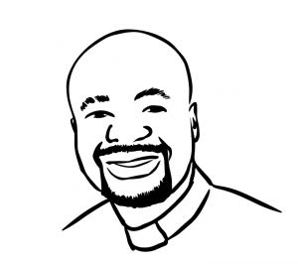

Dear Teacher
Thank you for taking your time to facilitate the “Let’s talk about race” training to your class.
The following slides come with teacher notes below each slide. Please feel free to edit and personalise for your class.
As the vocabulary and concepts are being introduced, please give time for the children to have discussions. Encourage them to use the words which they have learned. Most importantly, I hope that your children will reflect,
think deeply and apply their gained knowledge to their lives.
As this training program is for five days, taking about 20 minutes per day, I hope that at the end of the training, the children can continue to have discissions and take action for racial justice.
You can download a free printable certificate template and display board. You can also take part in follow up activities from my website www.malewezi.com
To give feedback on the effectiveness of this program, please scan the QR code or click on the link on the last slide.
Kind regards and blessings,
Rev. Dcn. Justin Malewezi Jnr.
FHEA Fellow, MRes, QTS, BA Hon, Cert PM
j.malewezi@rcaol.org.uk
www.malewezi.com
Notes:
You may hide this slide

Slide 2
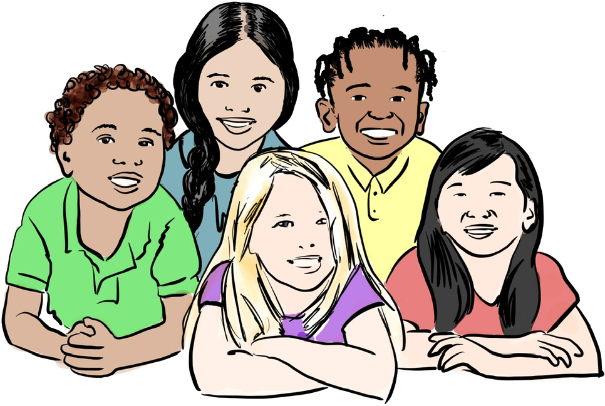

Day 1
Let’s talk about race
Notes:
About Rev Justin Malewezi the author
The word “Malewezi” means zebra stripes in Chichewa language in Malawi, Africa, where Rev. Justin was born and raised. After several years working for the United Nations agencies in Malawi, Rev Justin taught in a primary, secondary school and college in England. Then he became a university lecturer and researcher.
More about his work can be seen on www.malewezi.com

Slide 3
Day 1
What do you know about race and how to go against racism?
Notes:
Let them have silent thinking time to privately jot down in one colour, in the middle of A4 piece of paper, their responses to the question displayed. We will come back to this later on day 5

Slide 4
Discuss with the person next to you.
What races are these children?
How can you tell?
Day 1
Black
Multiracial
Brown?
White
Notes:
Give 1 minute for discussions and then ask them to share their responses to the whole group. For example, I can tell the Boy is black because …. etc.

Slide 5
Discuss with the person next to you.
What races are these children?
How can you tell?
Day 1
Human Race
Black
Multiracial
Brown?
White
Notes:
In the true sense, we all belong to one race, the human race. We are all the same under our skin and that is what makes us belong to the same human race.
As a society we are stuck with the word “race” and we use it anyway to describe people according to the colour of their skins and other physical features.

Slide 6
Describe the ethnicity of each child with a word or two from the word bank
Day 1
Word Bank
Black x2
White
African
Caribbean
Indian
Irish
Chinese
5
1
4
2
3
Notes:
The word “Black” can be used twice
Ethnicity tells us a bit more than the colour of their skin (race)
The term ethnicity describes a group of people who share the same cultural identity, such as geographical origin, common language and religion
We can describe or identify each other by race or ethnicity, but the best way is by …

Slide 7
Learn each other’s names and call each other by name.
Day 1
Arya
Kizito
Aaron
Chen
Kate
Notes:
… name

Slide 8
Day 1
P4C Discussion of the day
  What if people had the power of a chameleon and they could change their skin colour, do you think people would use this power? Why?
  What would happen if they did?
  Discuss now then later take the conversation home.
Notes:
Philosophy for children (P4C) discussion
Children to sit in a circle facing each other
When one person speaks others should listen. You may use a speaking soft toy, for only the holder of the toy speaks
Encourage children to build on each other’s comments, refrain to each other by name
Stop here for today … encourage the children to continue having this discussion at home.

Slide 9
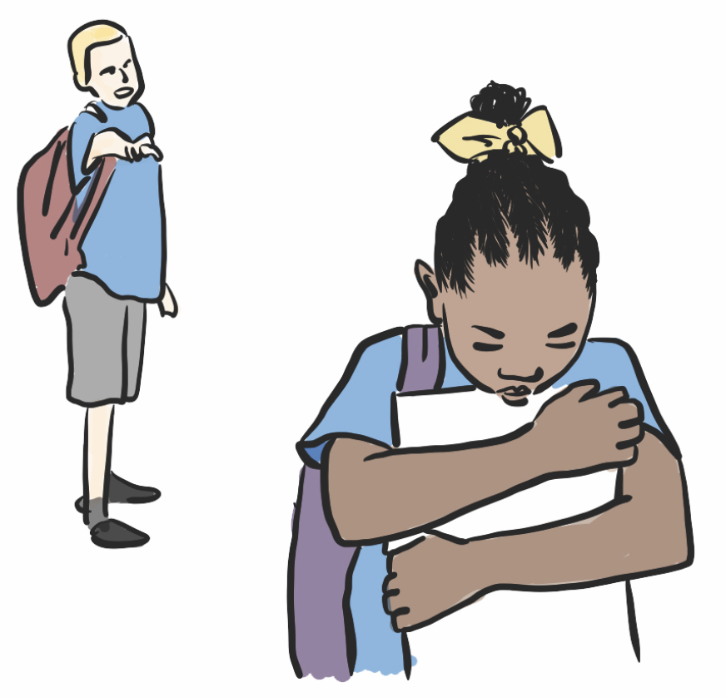
Is this racism? Why?
Discuss with the person next to you.
Child (A) is making jokes about the hair of child (B).
Day 2
A
B
Notes:
Some people think that despite us being the same under our skin, others ‘races’ are better than the rest.
This can be in form of a thought, attitude, action, policy, or institution.
For the people who are regarded inferior, racism leads to hurt and suffering. That is racism.
Sometimes, when people are hurt by racism for a long time, they start to believe that they are indeed inferior. This is called internalised racism.

Slide 10
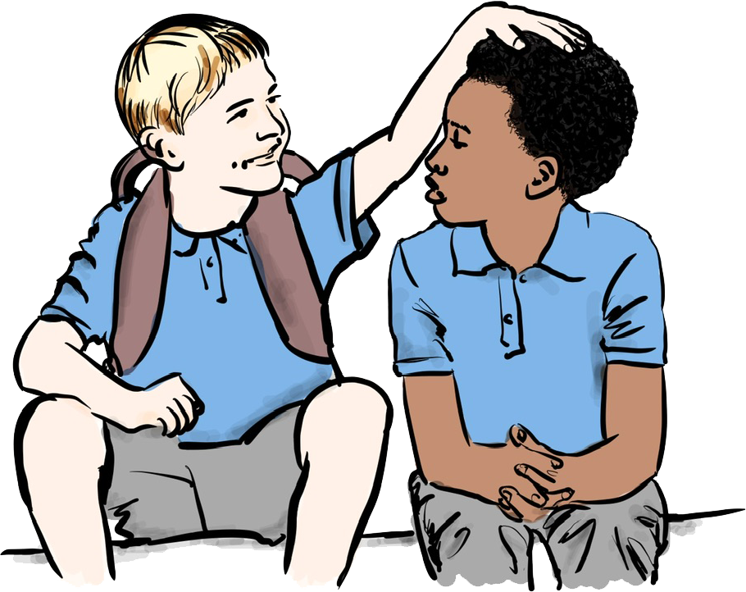
Is this racism? Why?
Discuss with the person next to you.
Child (A) is making an insignificant and harmless but hurtful commenting about about the hair of child (B).
Day 2
A
B
Notes:
This is Micro-aggression … comments or actions that may seem insignificant and harmless but in fact hurtful. Just like racism, it still leads to hurt.
Any comment that is about skin colour or physical characteristics of an ethnic group, apart from identification, can be hurtful and is best avoided.
You need to speak to people as people and not as people of a certain skin colour.

Slide 11
Where are you actually from?
Day 2
You people …
Your name is difficult to pronounce
Your English is good.
Can I touch your hair?
I don’t see colour
Notes:
Here are some examples of Micro-aggression … again the words may seem harmless but in they are hurtful

Slide 12
Day 2
P4C Discussion of the day
  Do you think racism and micro-aggression still happens today? Why?
  Discuss now then later take the conversation home.
Notes:
Philosophy for children discussion
Children to sit in a circle facing each other
When one person speaks others should listen. You may use a speaking soft toy, for only the holder of the toy speaks
Encourage children to build on each other’s comments, refrain to each other by name
Stop here for today … encourage the children to continue having this discussion at home.

Slide 13
Kizito was in a football team which almost everyone belonged to the same ethnicity as him.
What can be good or bad about being in such a team?
Discuss with the person next to you.
Day 3
Notes:
Allow the group to discuss

Slide 14
Then he joined another team where everyone was of a different ethnicity from him.
What can be good or bad about being in such a team?
Discuss with the person next to you.
Day 3
Notes:
As Kizito moves from the position of ethnic majority to minority, he could face racism.
This is called Racial Positioning

Slide 15
Joe has joined Kizito’s old team.
What can be good or bad about being in such a team?
Discuss with the person next to you.
Day 3

Slide 16
Sam, a multi-ethnic child has played for both teams.
What can be good or bad about Sam being in each team?
Discuss with the person next to you.
Day 3
Notes:
When people are positioned in a place where they are an ethnic minority, they can easily become a target for racism. We need to become a society that is sensitive to people who look different from us and make deliberate effort to welcome them and make them “feel at home”.

Slide 17
Day 3
P4C Discussion of the day
  If you had someone new in your school of a different ethnicity than most, how would you make the person feel welcome? Why is that important?
  Discuss now then later take the conversation home.
Notes:
Philosophy for children discussion
Children to sit in a circle facing each other
When one person speaks others should listen. You may use a speaking soft toy, for only the holder of the toy speaks
Encourage children to build on each other’s comments, refrain to each other by name
Stop here for today … encourage the children to continue having this discussion at home.

Slide 18
What is Unconscious Racial Bias?
Any comments or reflections?
Day 4
  Action:
  Do some cleaning up. Think and say good things about non-white people.
Notes:
In the next three slides ... Encourage the children to discuss, make comments and reflections. You can spend 5 min per slide.
We speak about the things that we have thought of again and again in the past. At times, we speak without thinking. This is because of the way the human brain works. Our brain makes many decisions for us, all the time. For example, a driver does not have to think about indicating or changing gears, this is done by our brain automatically. This is because, once we have learnt something, the brain keeps it in memory so that it can be automatically used again in the future. There can be negative things that people repeatedly hear about “race” that their brain keeps and uses automatically without thinking. This is called racial unconscious bias.
As individuals, we need to do some cleaning up of the unconscious racial bias that our brain has kept for a long time. Think and say good things about non-white people.

Slide 19
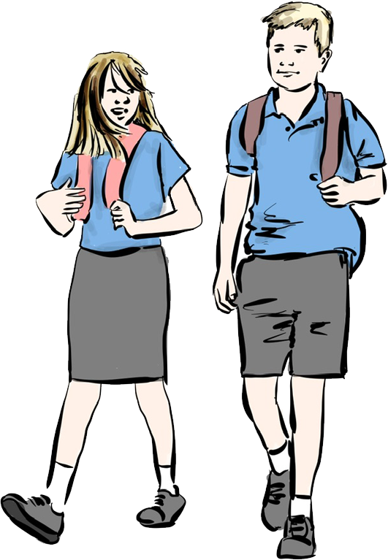
What is White Privilege?
Any comments or reflections?
Day 4
  Action
  Be aware of it and stand up for those without it.
Notes:
White people have the privilege of walking down the road without negative interactions from others due to the colour of their skin. People who are not white do not have this privilege. Other privileges include education, employment, housing, healthcare, and interactions with law enforcement. Most white people are not aware of these privileges until made apparent through witnessing the struggle of people who are not white.
Encourage the children to discuss, make comments and reflections. You can spend 5 min per slide.
You may conclude with … be aware of white privilege and stand up for those without it …

Slide 20
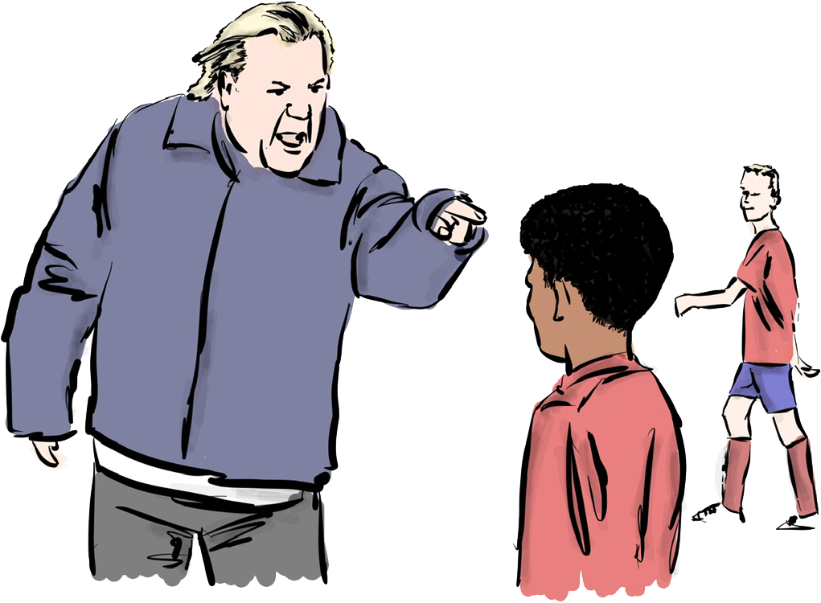
What is Adultification?
Any comments or reflections?
Day 4
  Action
  All children are children. Remind adults about this.
Notes:
There is a tendency that some white adults see black children to be older than they are. This is called adultification. It is common for black children, to receive unfair treatment from white adults, at school, on the bus, on the street, by law enforcement and other places.
... Encourage the children to discuss, make comments and reflections. You can spend 5 min per slide.
You may conclude with … “All children are children. All adults must remember this.”

Slide 21
Day 4
What actions can you take against …
  Unconscious Racial Bias
  Do some cleaning up. Think and say good things about non-white people.
  White privilege
  Be aware of it and stand up for those without it.
  Adultification
  All children are children. Remind adults about this.
Notes:
Philosophy for children discussion
Children to sit in a circle facing each other
When one person speaks others should listen. You may use a speaking soft toy, for only the holder of the toy speaks
Encourage children to build on each other’s comments, refrain to each other by name
Stop here for today … encourage the children to continue having this discussion at home.

Slide 22
What is being anti-racist?
Any comments or reflections?
Day 5
Notes:
Ignoring racism adds to racism, because racism is allowed to carry on as normal. We need to be a society that does not stand-by and watch a racist incident happening. Racism is unacceptable and we must always challenge it.
To be anti-racist is to go against racism. This starts with firmly believing that we are all the same under our skin. We all belong to one race, the human race. We should therefore respect each other as equal people.

Slide 23
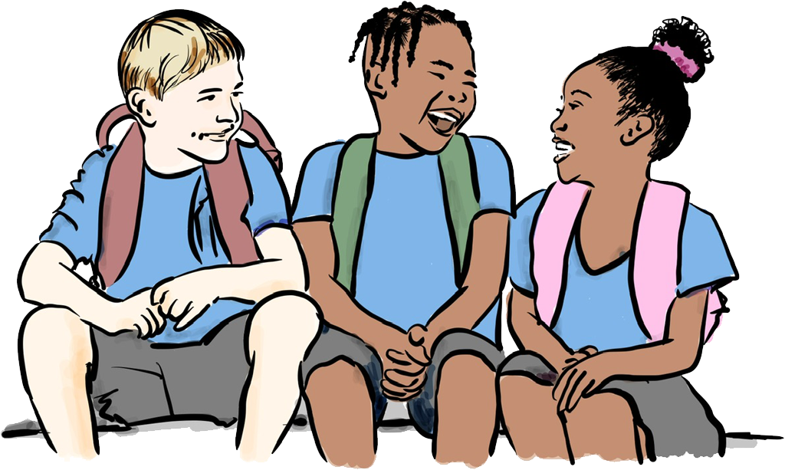
How can one be anti-racist?
Any comments or reflections?
Day 5
1
2
3
Believe that we are the same.
Clean up your unconscious racial bias.
Talk to people as people.
Notes:
1- Firmly believe that although we look different, we are all the same under our skin.
2- Take time to think about negative things that you have heard repeatedly about race. Truly consider how wrong and unfair these statements are. Then repeatedly say to yourself true and kind statements about your race and others. Do this frequently to clean up your unconscious racial bias.
3- Talk to a person as a person and not a person of a certain skin colour. Sometimes we are afraid to talk to people of a different race because we might say the wrong thing. Talk to them beyond their skin colour or physical features. Talk to them about their interests, cultural identity, religion, geographical origin, language, literature and so on.

Slide 24
Day 5
Think, Pair, Share
So, what do you now know about race and how to go against racism?
Go back to your knowledge map, discuss and jot down what you now know, in another colour.
“Keep talking about race”
Notes:
Encourage the children to keep talking about race

Slide 25
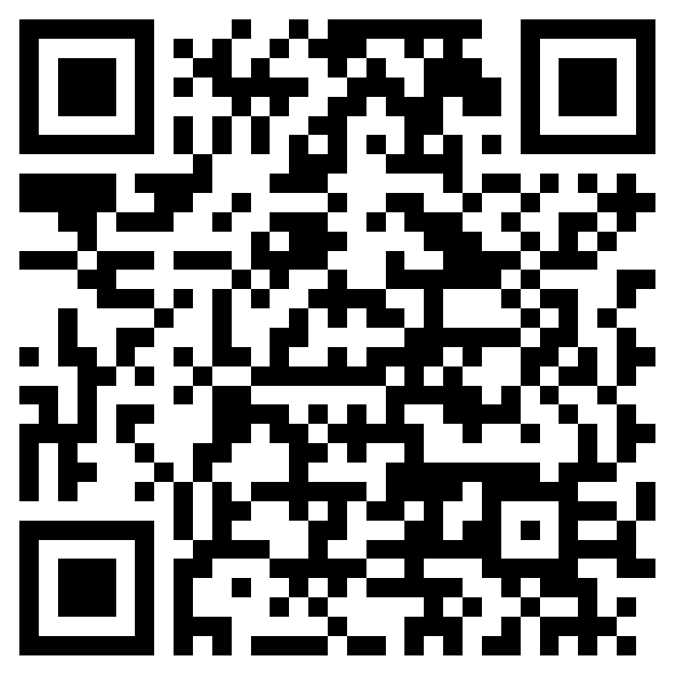
Dear Teacher
Thank you once more for taking your time to facilitate the the “Let’s talk about race” training to your class. How did it go?
I would really appreciate your feedback on the effectiveness of this program.
Kind regards,
Rev. Dcn. Justin Malewezi Jnr.
FHEA Fellow, MRes, QTS, BA Hon, Cert PM
j.malewezi@rcaol.org.uk
Feedback form link
Notes:
You may hide this slide

