Slide 1
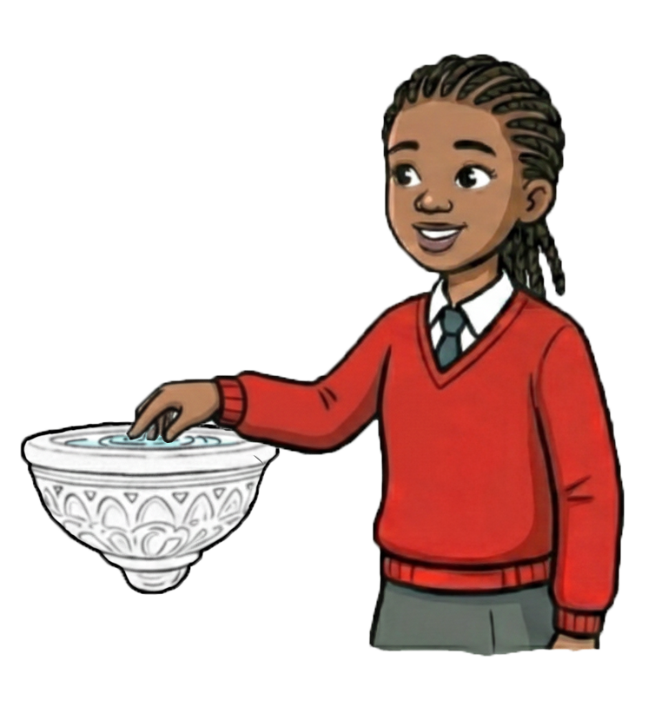
The Sign of the Cross at the Holy Water Font

Slide 2

Learning Objectives
To know about the Sign of the Cross at the Holy Water Font:
What is it?
How does it connect to scripture?
How did it develop?
What does it mean to me and others?

Slide 3
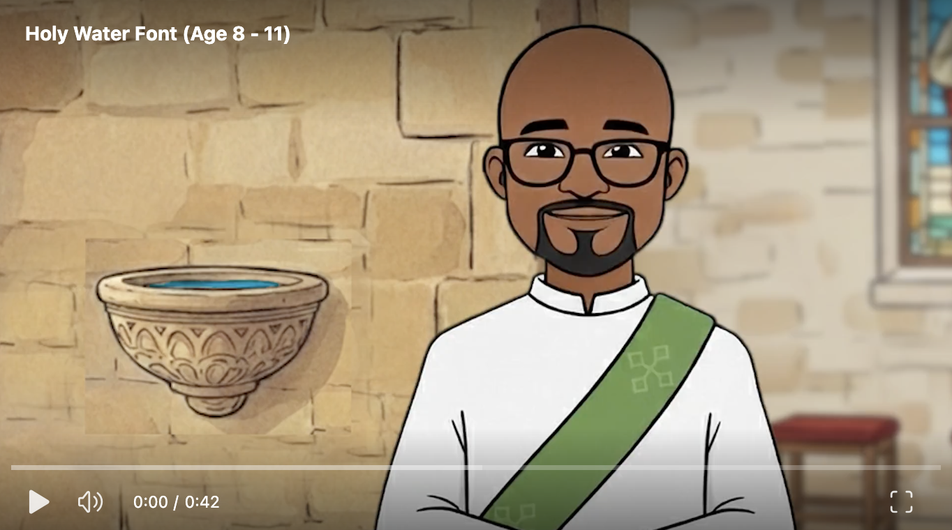
What is it?

Slide 4
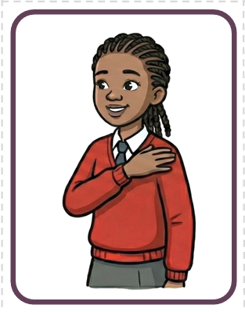
What is it?
The Sign of the Cross is a very short prayer that summarises everything we believe in just a few seconds.

Slide 5
What is it?
Work in groups.
Can you sort the cards to remember how to make the sign of the cross?
What does each stage mean?
What scripture connects to each stage?

Slide 6
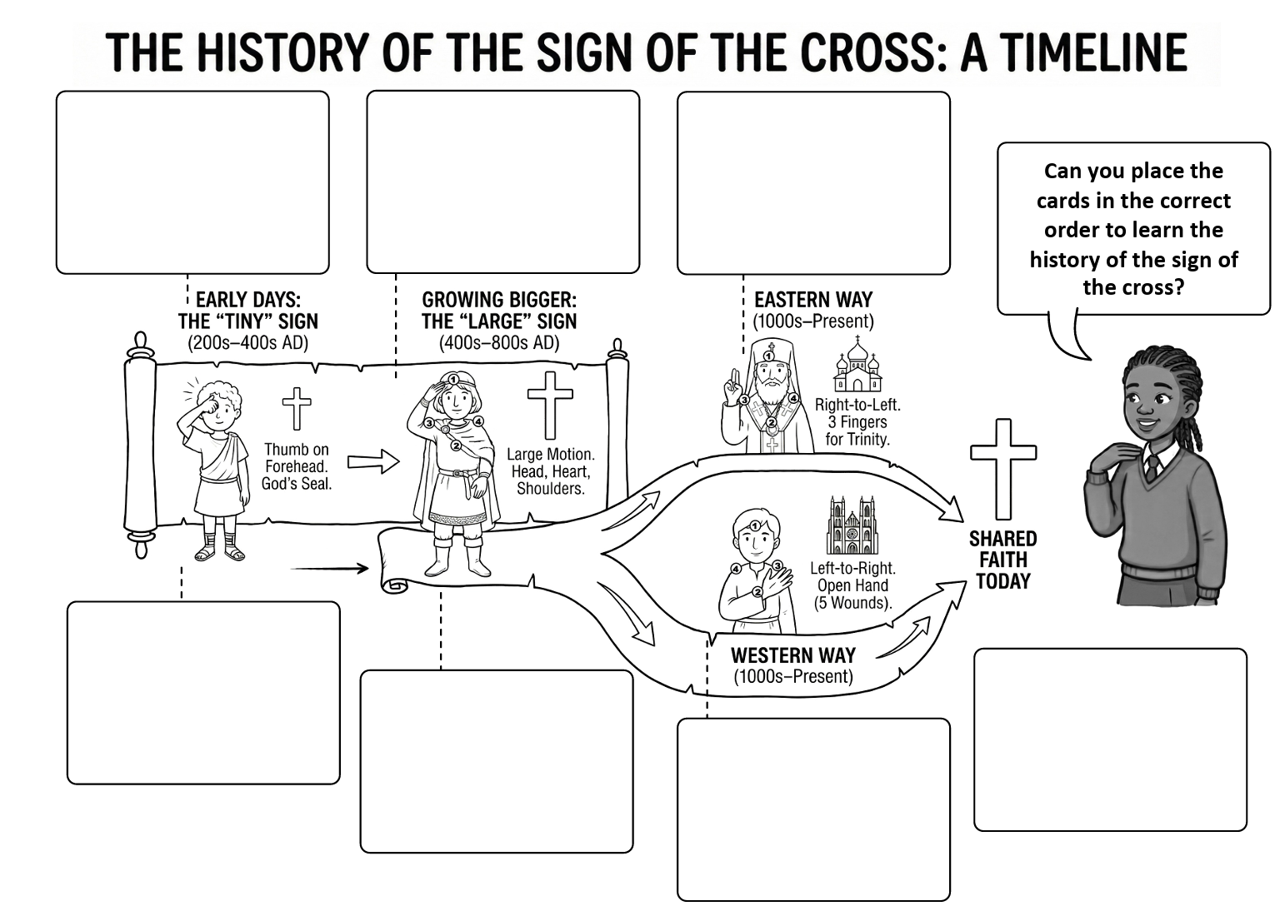
What is it?
The Sign of the Cross started at at Baptism. Think of it like putting on a football shirt or a team kit. When new people joined the Church, the priest would mark them with the cross to show they were now on 'Team Jesus.' They were being claimed for Christ.

Slide 7
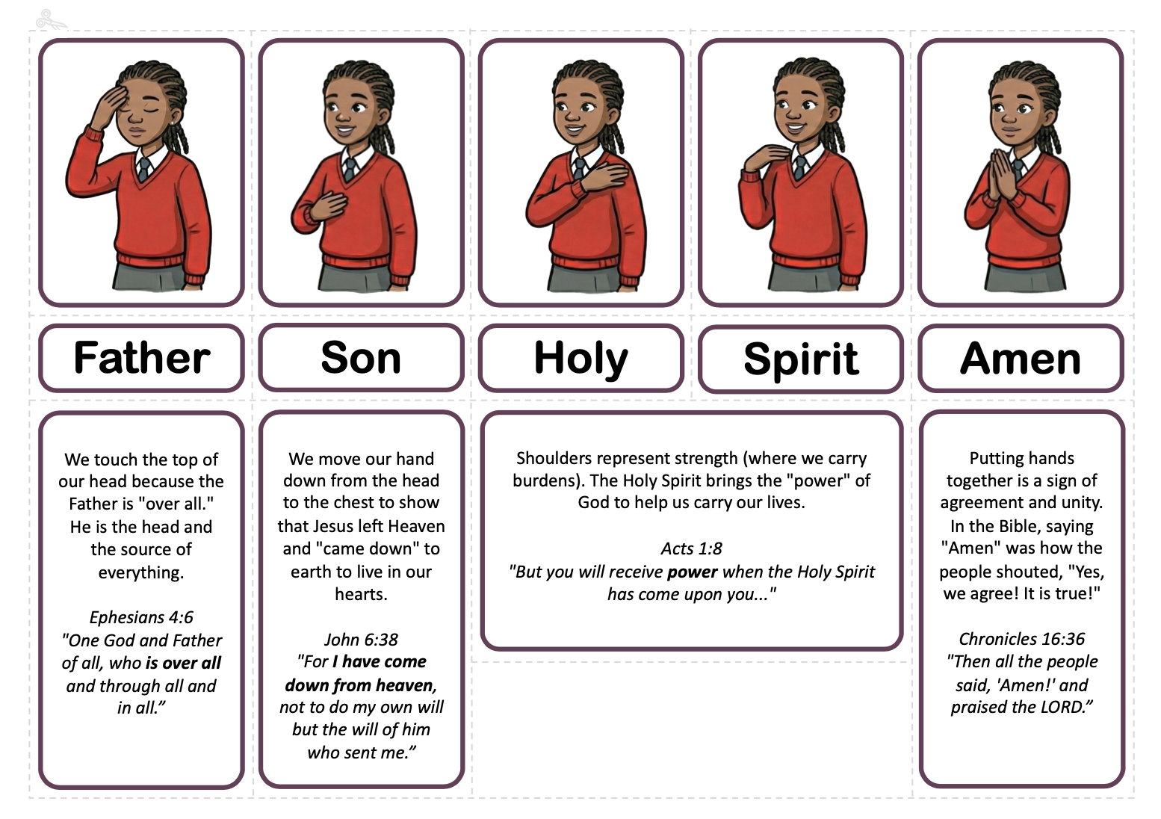
How does it connect to scripture?

Slide 8

How does it connect to scripture?
Highlight which parts connects to the Father, Son and Holy Spirit ------------------------------------------------------------------------------------------------------------------------------------ ¹⁶ And when Jesus was baptised, he went up immediately from the water, and behold, the heavens were opened and he saw the Spirit of God descending like a dove, and alighting on Him; and lo, a voice from heaven, saying, “This is my beloved Son, with whom I am well pleased.” Matthew 3:16-17 RSVCE

Slide 9
How does it connect to scripture?
Highlight which parts connects to the Father, Son and Holy Spirit ------------------------------------------------------------------------------------------------------------------------------------ ¹⁶ And when Jesus was baptised, he went up immediately from the water, and behold, the heavens were opened and he saw the Spirit of God descending like a dove, and alighting on Him; and lo, a voice from heaven, saying, “This is my beloved Son, with whom I am well pleased.” Matthew 3:16-17 RSVCE

Slide 10
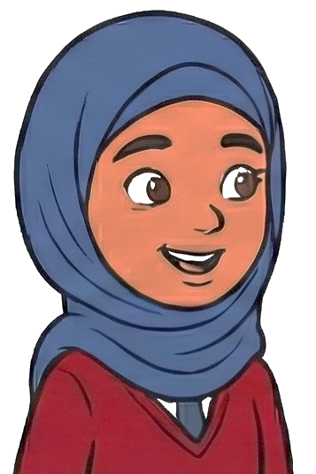
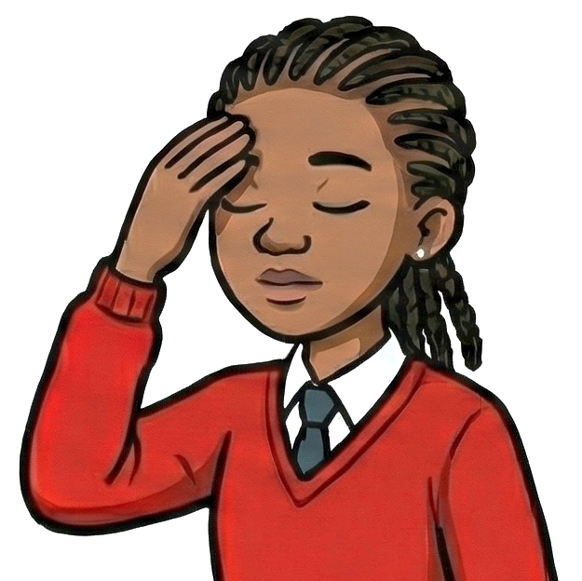
What does it mean to me and others?
"Before I start my prayer, I make the Sign of the Cross to tell my body it is time to be quiet and listen to God."
"I do something similar, but I use water. Before I pray, I wash my face, arms, and feet called Wudu to make sure I am clean and ready for Allah."
Aisha (Muslim)
"I also use water, when I enter the Church. I dip my fingers in holy water and make the sign of the cross. Just like you Aisha, that prepares me to enter a holy place."
Kuwala (Catholic Christian)
"Before I start my prayer, I make the Sign of the Cross to tell my body it is time to be quiet and listen to God."
"I do something similar, but I use water. Before I pray, I wash my face, arms, and feet called Wudu to make sure I am clean and ready for Allah."
"I also use water, when I enter the Church. I dip my fingers in holy water and make the sign of the cross. Just like you Aisha, that prepares me to enter a holy place."
Kuwala (Catholic Christian)
Aisha (Muslim)

Slide 11
What does it mean to me and others?
"I believe God is One, but He is also three persons; Father, Son and Holy Spirit."
"That is where we are different. I believe God is strictly One, so I don't use the number three."
Kuwala (Catholic Christian)
"I am like Aisha. We believe 'The Lord is One.' But, Kuwala, I do like how you touch your head and heart—we touch the Mezuzah on our door to remember God is close to us."
Eitan (Jewish)
Aisha (Muslim)

Slide 12
What does it mean to me and others?
"At the very end, I put my hands together for 'Amen.' It means I really believe it."
"I put my hands together too! When I see someone, I press my palms together to say Sat Sri Akal. It means I see the truth in you."
Kuwala (Catholic Christian)
Angad (Sikh)

Slide 13
What does it mean to me and others?
Philosophy or Children. Sit in a circle, talk and listen to each other. Is the Sign of the Cross a 'members-only' sign, or can anyone use it?”
Is the Sign of the Cross like a team kit (you should only wear it if you are on the team) or like a smile (anyone can use it)?
If a person who isn't a Christian makes the Sign of the Cross, is it still a prayer, or just a movement?
Is it respectful or disrespectful to use a sign from a religion you don't belong to?
Notes:
Discussion Guide: Deepening the Understanding
Listen to the children talking to each other. After each point, use these analogies to navigate the nuance between "belonging to the Church" and "reaching out to God.”
Is the Sign of the Cross a 'members-only' sign, or can anyone use it? The Nuance: It is the mark of the member, but not restricted like a password. The Discussion:
Ask: "Think about a football stadium. There are the players on the pitch (the team), but there are also thousands of fans wearing the scarf. Can you wear the scarf even if you aren't playing?"
Explain: Yes. The Sign of the Cross is the "uniform" of a Christian (Baptism), but anyone who wants to get closer to Jesus is allowed to "wear the scarf."
Key Concept: It is an Open Door, not a Locked Gate. It was given to the Church, but the Church’s doors are open. If someone wants to try it to see how it feels to talk to God, they are welcome.
Is it like a team kit (only for the team) or a smile (anyone can use it)? The Nuance: It sits right in the middle. It is more specific than a smile, but more inviting than a private kit.
The Discussion:
Ask: "Can you sing a song from a movie even if you weren't in the movie? Can you use a greeting word from a language you don't speak fluently (like 'Bonjour' or 'Namaste')?"
Explain: Yes. When you say "Namaste," you are borrowing a greeting to show respect.
Key Concept: It is a Language. The Sign of the Cross is "Body Language" for the Trinity (Father, Son, Holy Spirit). Christians speak this language fluently because it is our "mother tongue." Others can use it like a "borrowed phrase" to say hello to God respectfully.
If a person who isn't a Christian makes the Sign of the Cross, is it still a prayer, or just a movement?
The Nuance: This depends entirely on the heart.
The Discussion:
Ask: "If a parrot says 'I love you,' does it mean it? What about if a toddler says it?"
Explain: The parrot is just making noise (movement). The toddler might not understand the full meaning, but they know they feel love (prayer).
Key Concept: The Magic Ingredient is 'Why'.
If a non-Christian does it just to copy their friend or swat a fly? It’s just a movement.
If they do it because they are curious, sad, or want to ask God for help? It is a prayer. God looks at the heart, not the label on the person.
Is it respectful or disrespectful to use a sign from a religion you don't belong to?
The Nuance: Distinction between Mockery vs. Reverence.
The Discussion:
Ask: "Imagine you go to a friend's house for dinner and their family holds hands to say grace. If you hold hands too, are you being rude or polite?"
Explain: You are being polite! You are joining in their custom.
Key Concept: Imitation is the highest form of respect (usually).
Respectful: Doing it slowly and carefully when you are in a church or praying with friends, to show you care about what they care about.
Disrespectful: Doing it quickly, laughing while doing it, or using it as a joke when you score a goal in FIFA just to look cool. That turns a holy sign into a toy.

Slide 14
What does it mean to me and others?
Philosophy or Children. Sit in a circle, talk and listen to each other. If a non-believer dips their hand in the font, do they get blessed or just wet?
Is the Sign of the Cross like a team kit (you should only wear it if you are on the team) or like a smile (anyone can use it)?
If a person who isn't a Christian makes the Sign of the Cross, is it still a prayer, or just a movement?
Is it respectful or disrespectful to use a sign from a religion you don't belong to?
Notes:
Discussion Guide: The "wet" vs. "Blessed" Debate
Listen to the children talking to each other. After each point, use these analogies to explain how physical objects relate to spiritual beliefs.
If a non-believer dips their hand in the font, do they get blessed or just wet?
The Misconception: That Holy Water is like "magic potion" that zaps you, or conversely, that it is "just tap water" with no meaning at all. The Discussion:
Ask: "Imagine I throw a ball to you. If you catch it, we are playing a game. If you keep your hands in your pockets and the ball hits you, are we playing? Or did you just get hit by a ball?"
Explain: The "Blessing" is the ball. God throws it. The water carries it.
Key Concept: The Catching is the Believing.
The water is always special (it carries the blessing).
If a believer touches it, they "catch" the blessing because their heart is ready.
If a non-believer touches it, they physically get wet. However, if they touch it with a curious or kind heart, God sees that "open hand" and might give them a little blessing anyway—a feeling of peace or wonder.
Is the Sign of the Cross (with water) like a team kit or a smile?
The Nuance: Focusing on the ownership of the symbol.
The Discussion:
Ask: "Think about a public park. The Council owns it and maintains it (like the Church maintains the tradition). But is the park only for the Mayor? Or can anyone walk in and enjoy the fresh air?"
Explain: The Church "owns" the font, but the water is for everyone who is thirsty for God.
Key Concept: It is an Invitation. A team kit is exclusive—you can't wear it if you aren't on the roster. A smile is universal. Holy Water is like a Welcome Mat. It is there for the family (believers), but it is also there to welcome guests. Using it doesn't make you a member instantly, but it says "I am happy to be in this house.”
If a non-Christian makes the Sign of the Cross, is it still a prayer?
The Nuance: Can you pray if you don't know who you are praying to?
The Discussion:
Ask: "If you are lost in a foreign country and you shout 'Help!' in English, even though the locals speak French... are you still asking for help?"
Explain: Yes. You are crying out. Someone will understand you.
Key Concept: God Needs No Translator.
If a non-Christian does the movement just to stretch their arm? It is just a movement.
If they do it because they are scared, or thankful, or wondering if God is real? It is a prayer. God understands "Body Language" perfectly. He knows they are knocking on His door.
Is it respectful or disrespectful to use a sign from a religion you don't belong to? The Nuance: The difference between Appropriation (taking) and Participation (joining).
The Discussion:
Ask: "Imagine you go to a museum. You are allowed to look at the art. But are you allowed to touch the paintings with sticky fingers? Or draw a moustache on the portraits?"
Explain: No, because you must treat valuable things gently.
Key Concept: The "Tourist" Rule.
Respectful: A "tourist" in the Church (a non-believer) can use the water if they do it slowly and seriously, to see what it feels like. That is learning.
Disrespectful: Using Holy Water to cool down on a hot day, or flicking it at your brother. That treats something holy like a toy. It doesn't hurt God, but it shows that you don't have good manners yet.
Suggested Class Activity: "The Open Door"
The "Wi-Fi" Analogy: Draw a Wi-Fi router on the board and label it "Holy Water Font." Draw two smartphones.
Phone A is logged in (Believer). It gets the signal (Grace).
Phone B is on Airplane Mode (Closed heart/Mocking). It is sitting right next to the router, but it gets no signal.
Discussion: Ask the children—how do we turn "Airplane Mode" off? (By being quiet, respectful, and open to God).
The "Heart Check": Create a simple checklist for the children to mentally "tick" before they use Holy Water:
[ ] Am I rushing?
[ ] Am I joking?
[ ] Am I ready to say hello to God?

Slide 15
Self Check
Now, what do you know about the Sign of the Cross at the Holy Water Font:
What is it?
How does it connect to scripture?
How did it develop?
What does it mean to me and others?

