Slide 1
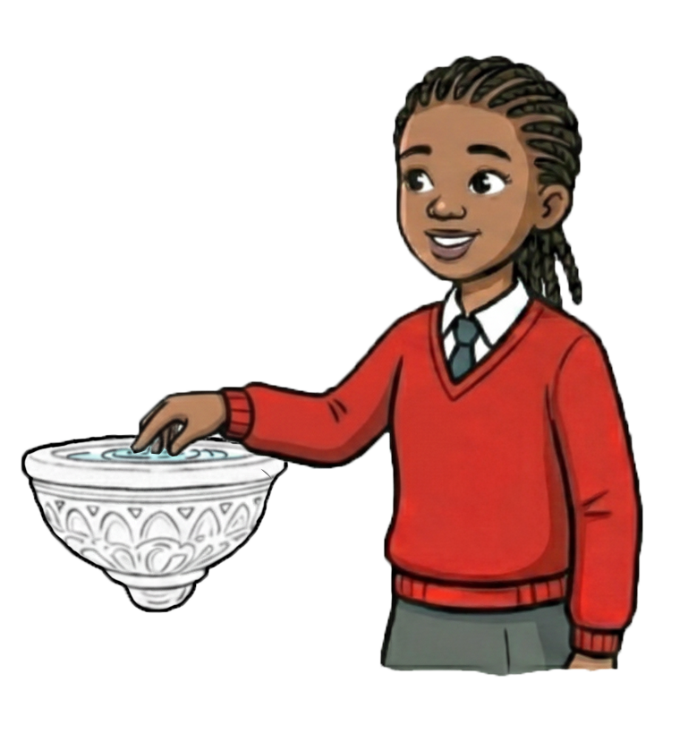
The Sign of the Cross at the Holy Water Font

Slide 2

Learning Objectives
To know about the Sign of the Cross at the Holy Water Font:
What is it?
How does it connect to scripture?
How did it develop?
What does it mean to me and others?

Slide 3
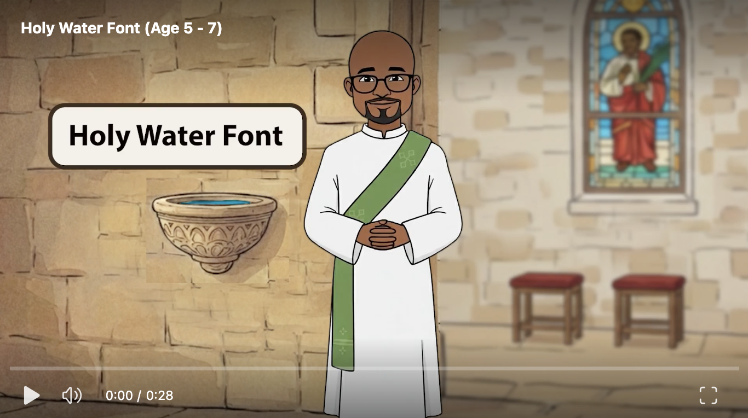
What is it?

Slide 4
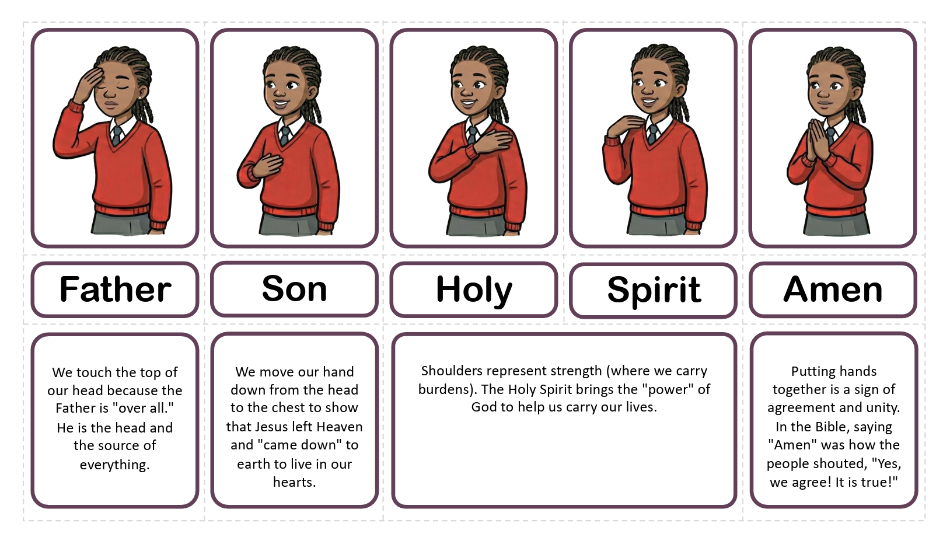
What is it?
The Sign of the Cross is our family badge. Just like you wear a uniform for school, we make this sign to show we belong to God’s Family.

Slide 5
What is it?
Work in groups.
Can you sort the cards to remember how to make the sign of the cross?
What does each stage mean?

Slide 6
What is it?

Slide 7
What does it mean to me and others?
Philosophy or Children. Sit in a circle, talk and listen to each other. Is the Sign of the Cross like a badge that stays on you even after you take your hand away?
If no one sees you do it, are you still wearing the badge?
Does making the shape with your hand change who you are in that moment?
Notes:
Discussion Guide: Correcting Misconceptions
Listen to the children talking to each other. After each point, use the following script and analogies to summarise the conversation and correct misconceptions.
Is the Sign of the Cross like a badge that stays on you?
The Misconception: Once I put my hand down, the cross is gone.
The Discussion:
Ask: "When you finish a hug, does the love disappear just because your arms aren't holding the person anymore?"
Explain: No. The Sign of the Cross is like an invisible badge. It reminds us of our Baptism (when we were welcomed into God's family).
Key Concept: When you make the Sign of the Cross, you are reminding yourself that you already wear the badge of God’s love on your heart. You are tracing over a mark that is always there!
If no one sees you do it, are you still wearing the badge?
The Misconception: If the teacher or my friends don't see it, it didn't happen (common "object permanence" thinking in young children. Child's ability to know that objects continue to exist even though they can no longer be seen or heard.). The Discussion:
Ask: "If you have a secret thought in your head, is it still real even if I can't see it?"
Explain: Yes. God sees everything, even the secrets in our hearts.
Key Concept: You are "wearing the badge" (being God’s child) even when you are alone in your room or playing in the park. The Sign of the Cross is a special code between you and God. He always sees it.
Does making the shape change who you are in that moment?
The Misconception: It is a "magic trick" or a superhero transformation that changes me into a different person.
The Discussion:
Ask: "When you put on your school uniform, do you become a different person, or does it just help you remember to be ready to learn?"
Explain: It doesn't change who you are—you are always a child of God. But it changes what you are ready for.
Key Concept: It is a "Ready, Steady, Go" for prayer. It helps our brains and hearts wake up and focus on God. It invites Jesus to be in our thoughts (head), our words (mouth), and our feelings (heart).

Slide 8
What does it mean to me and others?
Philosophy or Children. Sit in a circle, talk and listen to each other. "If you put Holy Water in a normal cup, does it stop being special?"
If no one sees you do it, are you still wearing the badge?
Does making the shape with your hand change who you are in that moment?
Can you say "hello" to God without using your voice?
Notes:
Discussion Guide: Deepening the Understanding
Listen to the children talking to each other. After each point, use these analogies to help 7–8 year olds grasp the difference between the container and the contents, and the difference between actions and intentions.
If you put Holy Water in a normal cup, does it stop being special?
The Misconception: The "specialness" comes from the fancy gold bowl or the church building itself. If you take it out, the "magic" evaporates.
The Discussion:
Ask: "If I put a very expensive diamond ring inside an old cardboard lunchbox, does it turn into a piece of glass? Or is it still a diamond?"
Explain: It is still a diamond because of what it is, not where it is.
Key Concept: Holy Water is special because of the blessing, not the cup. A priest or deacon asked God to bless this water. That prayer doesn't fall off just because the water is in a plastic cup or a mug. However, because it is special, we usually choose to put it in a special cup to show respect (reverence), just like you wouldn't usually keep a diamond in an old lunchbox.
"If no one sees you do it, are you still wearing the badge?”
The Misconception: Validation is external. If the teacher didn't see me do the Sign of the Cross, I "missed" the prayer.
The Discussion:
Ask: "Think of your surname. If you go on holiday to a place where nobody knows you or your family, is that still your name?
Explain: No. Your name and family are part of who you are, no matter who is watching.
Key Concept: The 'Badge' is inside you. In Baptism, you were marked as a member of God's family. That mark is like a spiritual tattoo—it never washes off and it never fades, even if you are alone in your bedroom. The Sign of the Cross is just you touching that invisible badge to say, "I remember who I am.”
Does making the shape with your hand change who you are in that moment?
The Misconception: It changes me from a "naughty child" to a "good child" instantly, or it acts like a superhero suit.
The Discussion:
Ask: "Imagine a radio. It's always a radio, but sometimes it's just buzzing with static noise. When you tune it to the right station, what happens?"
Explain: The music comes through clear and loud. The radio didn't change into a toaster; it just tuned in to the signal.
Key Concept: It doesn't change who you are; it changes how you are thinking. You are always God's child. But when you make the Sign of the Cross, you are "tuning in" to God's frequency. You are stopping the static noise of the playground or the classroom to listen to God clearly.
Can you say 'hello' to God without using your voice?
The Misconception: Thoughts aren't "real" communication; only spoken words count as "official" prayer.
The Discussion:
Ask: "Have you ever sent a text message with just an emoji? Maybe a smiley face or a thumbs up? Did your friend understand it?"
Explain: The Sign of the Cross is like a prayer emoji or a text message to God.
Key Concept: God hears your heart. You can scream at God without opening your mouth, and you can whisper to Him just by thinking. Making the Sign of the Cross is a complete prayer that says, "In the name of the Father, Son, and Holy Spirit" without saying a single word. It is a secret code that everyone in the Church knows.

Slide 9
Self Check
Now, what do you know about the Sign of the Cross at the Holy Water Font:
What is it?
How does it connect to scripture?
How did it develop?
What does it mean to me and others?

