Slide 1
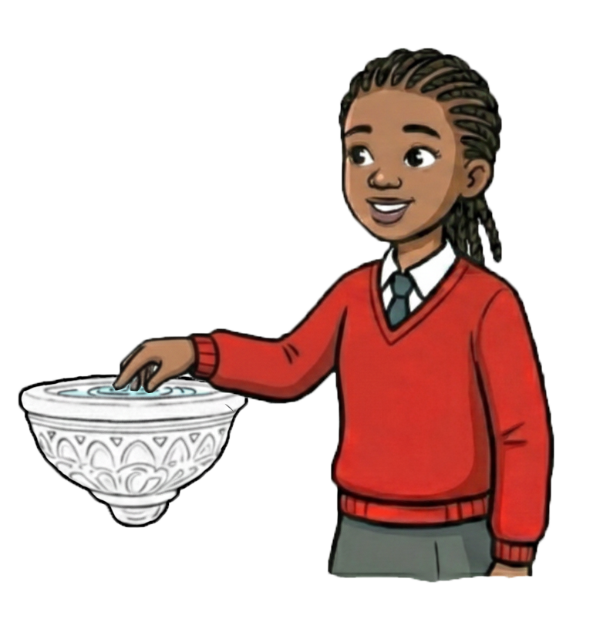
The Sign of the Cross at the Holy
Water Font

Slide 2

Learning Objectives
To know about the Sign of the Cross
at the Holy Water Font:
What is it?
How does it connect to scripture?
How did it develop?
What does it mean to me and others?

Slide 3
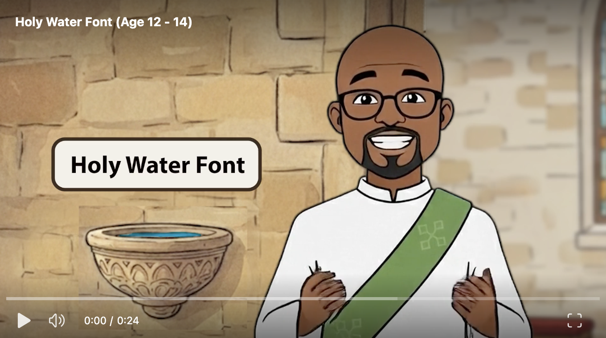
What is it?

Slide 4
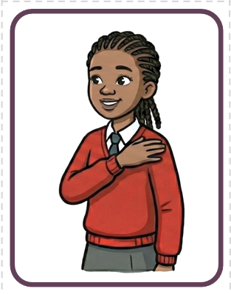
What is it?
The Sign of the Cross is a sacramental sign of discipleship. It is a conscious decision to place your life under the protection and authority of the Trinity.

Slide 5
What is it?
Work in groups.
Can you sort the cards to remember how to make the sign of the cross?
What does each stage mean?
What scripture connects to each stage?

Slide 6
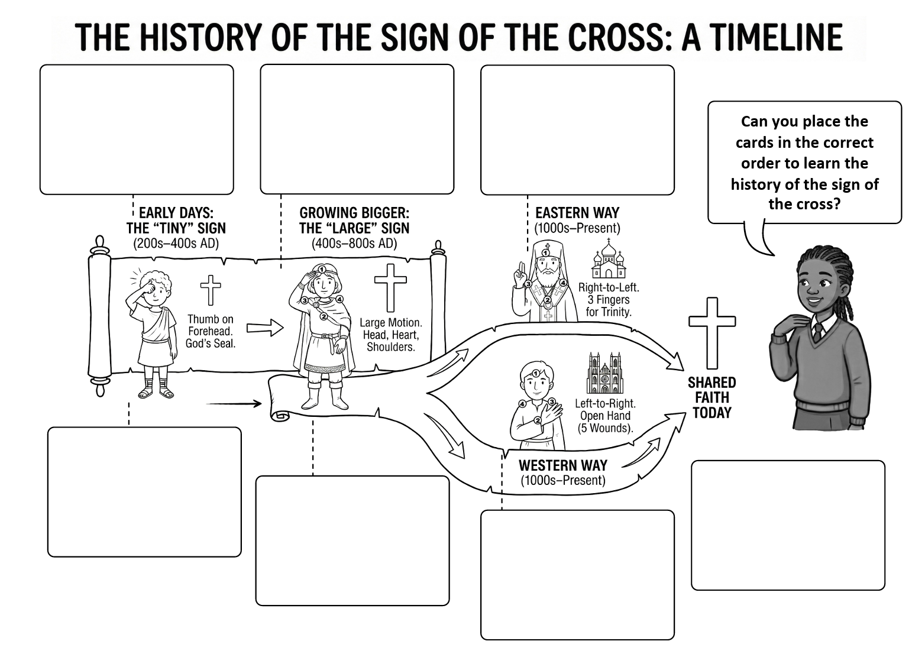
What is it?
The Sign of the Cross started at at Baptism. Think of it like putting on a football shirt or a team kit. When new people joined the Church, the priest would mark them with the cross to show they were now on 'Team Jesus.' They were being claimed for Christ.

Slide 7
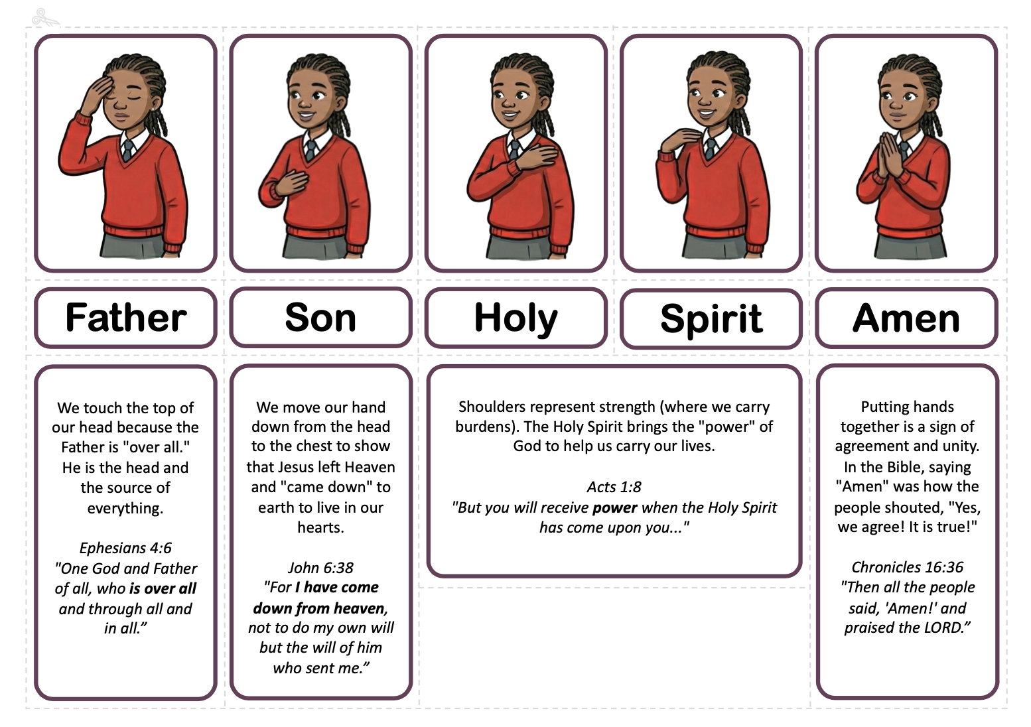
How does it connect to scripture?

Slide 8

How does it connect to scripture?
Highlight which parts connects to the Father, Son and Holy Spirit
------------------------------------------------------------------------------------------------------------------------------------
¹⁶ And when Jesus was baptised, he went up immediately from the water, and behold, the heavens were opened and he saw the Spirit of God descending like a dove, and alighting on Him; and lo, a voice from heaven, saying, “This is my beloved Son, with whom I am well pleased.” Matthew 3:16-17 RSVCE

Slide 9
How does it connect to scripture?
Highlight which parts connects to the Father, Son and Holy Spirit
------------------------------------------------------------------------------------------------------------------------------------
¹⁶ And when Jesus was baptised, he went up immediately from the water, and behold, the heavens were opened and he saw the Spirit of God descending like a dove, and alighting on Him; and lo, a voice from heaven, saying, “This is my beloved Son, with whom I am well pleased.” Matthew 3:16-17 RSVCE

Slide 10
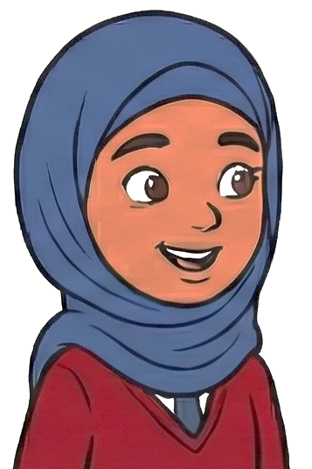
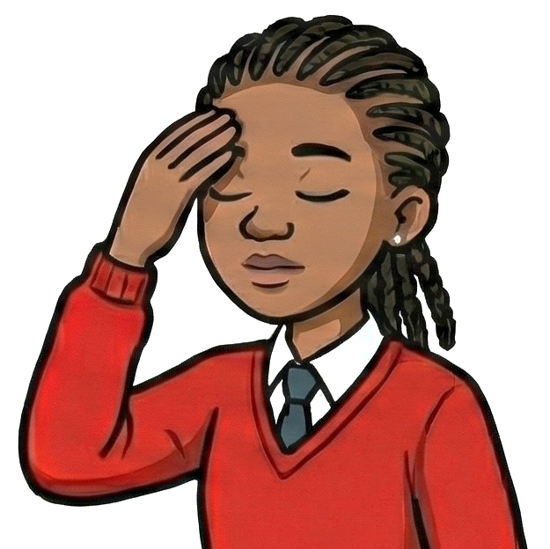
What does it mean to me and others?
"Before I start my prayer, I make the Sign of the Cross to tell my body it is time to be quiet and listen to God."
"I do something similar, but I use water. Before I pray, I wash my face, arms, and feet called Wudu to make sure I am clean and ready for Allah."
Aisha (Muslim)
"I also use water, when I enter the Church. I dip my fingers in holy water and make the sign of the cross. Just like you Aisha, that prepares me to enter a holy place."
Kuwala
(Catholic Christian)
"Before I start my prayer, I make the Sign of the Cross to tell my body it is time to be quiet and listen to God."
"I do something similar, but I use water. Before I pray, I wash my face, arms, and feet called Wudu to make sure I am clean and ready for Allah."
"I also use water, when I enter the Church. I dip my fingers in holy water and make the sign of the cross. Just like you Aisha, that prepares me to enter a holy place."
Kuwala
(Catholic Christian)
Aisha (Muslim)

Slide 11
What does it mean to me and others?
"I believe God is One, but He is also three persons; Father, Son and Holy Spirit."
"That is where we are different. I believe God is strictly One, so I don't use the number three."
Kuwala
(Catholic Christian)
"I am like Aisha. We believe 'The Lord is One.' But, Kuwala, I do like how you touch your head and heart—we touch the Mezuzah on our door to remember God is close to us."
Eitan
(Jewish)
Aisha (Muslim)

Slide 12
What does it mean to me and others?
"At the very end, I put my hands together for 'Amen.' It means I really believe it."
"I put my hands together too! When I see someone, I press my palms together to say
Sat Sri Akal. It means I see the truth in you."
Kuwala
(Catholic Christian)
Angad
(Sikh)

Slide 13
What does it mean to me and others?
Philosophy or Children.
Sit in a circle, talk and listen to each other.
A student in assembly doesn't believe in God but makes the Sign of the Cross so they don't stand out. What’s your take on this?
Notes:
Discussion Guide: "The Camouflage Prayer"
Listen to the students talking to each other. Use these points to validate the student's feelings (wanting to fit in) while gently encouraging honesty/integrity.
The Chameleon Effect
The Scenario: The student feels like everyone is looking at them, so they copy the movement to "disappear" into the crowd.
The Discussion:
Ask: "Does anyone know what a chameleon does when it feels nervous? (It changes color to match the leaves). Why?"
Explain: It does it to hide. Sometimes, we make the Sign of the Cross because we want to hide, so nobody asks us, "Why aren't you praying?"
Key Concept: God sees the Chameleon. Making the sign to fit in isn't "bad"—God isn't angry that you are nervous! But it turns the prayer into a mask. It becomes something you do for people, not for God.
The "Lip-Sync" Analogy
The Scenario: Doing the actions without the belief.
The Discussion:
Ask: "Have you ever seen a singer lip-sync? They move their mouth perfectly, but no sound is coming out. They are performing, not singing."
Explain: When we make the Sign of the Cross just to fit in, we are "Lip-Syncing to God." We are copying the moves, but our heart’s volume is turned down to zero.
Key Concept: Honesty is better than Performance. God prefers an honest heart over a fake hand movement.
What’s the "Take"? (Is it wrong?)
The Nuance: It is not a sin, but it is a missed opportunity for honesty.
The Discussion:
Ask: "If you go to a football match for a team you don't support, do you have to kiss the badge on the shirt? Or can you just clap politely?"
Explain: You don't have to fake it.
Key Concept: The "Polite Guest" Rule. If you don't believe in God yet, you don't have to make the Sign of the Cross. That is okay!
Option A (The Fake): Do the sign so people think you are praying. (This is acting).
Option B (The Respectful Guest): Stand quietly, bow your head, and think your own thoughts while your friends pray. (This is Integrity).
Teacher Note: Emphasize that Option B is brave and respectful.
"Does the shape count if I don't mean it?”
The Discussion:
Ask: "If I sign a contract but I don't read it and I don't agree to it, is my signature worth anything?"
Explain: It’s just ink on paper.
Key Concept: The movement is the envelope; the belief is the letter. If you make the Sign of the Cross without belief, you are posting an empty envelope to God. He still receives it, and He knows who sent it, but He knows it's empty inside.

Slide 14
What does it mean to me and others?
Philosophy or Children.
Sit in a circle, talk and listen to each other.
If you dip your hand in the font but you are thinking about your phone, have you actually prepared yourself?
Notes:
Use these analogies to explain the disconnect between the Body (doing the action) and the Mind (thinking about the phone).
The "Zombie" Handshake
The Concept: Physical presence without mental presence.
The Discussion:
Ask: "Imagine you meet your favorite YouTuber or footballer. You shake their hand, but while you are doing it, you are looking over their shoulder at a pigeon eating a chip. Did you really meet them?"
Explain: Your hand met them, but you didn't. You missed the moment.
Key Concept: The Body is a Robot. If your brain is thinking about your phone, your hand is acting like a robot. You got your fingers wet, but you didn't say hello to God. You missed the "handshake.”
The "Locked Screen" Analogy
The Concept: Holy Water is meant to "unlock" our hearts for Mass.
The Discussion:
Ask: "If you type your password into your phone but you press one wrong number because you aren't looking, does it unlock?"
Explain: No. You pressed the buttons, but the code was wrong.
Key Concept: Focus is the Key. The Holy Water is a way to "unlock" yourself so you are ready to listen to God. If you are thinking about your phone, you are typing in the wrong password. You stay "locked"—your body is in the church, but your mind is still outside.
The "Umbrella" Effect
The Concept: Distraction acts as a barrier to grace.
The Discussion:
Ask: "If you stand in the rain wearing a diving suit and a helmet, do you get wet?"
Explain: The rain is falling, but it can't touch your skin.
Key Concept: Distraction is a Raincoat. God's grace (the blessing in the water) is trying to reach you. But if your mind is busy worrying about a text message, you have put up an umbrella. The blessing bounces off. You have to "take off the hood" (focus your mind) to actually get the benefit.
"Have you actually prepared yourself?”
The Answer: No. You have performed a routine, but you haven't prepared your heart.
The Discussion:
Ask: "Is it a sin? Is God upset?"
Explain: No, God isn’t upset—He knows we get distracted! But it is a waste.
Key Concept: The Reset Button. The good news is, you can press "reset." If you dip your hand and realise, "Oops, I was thinking about my phone," you can just pause, take a breath, and say "Sorry God, I'm here now," and do it again (or just say it in your heart).

Slide 15
Self Check
Now, what do you know about the Sign of the Cross at the Holy Water Font:
What is it?
How does it connect to scripture?
How did it develop?
What does it mean to me and others?

