Slide 1
AFRICAN PATTERN COMPUTING
A Computing activity from the book “Smile Back” by

Slide 2
Notes:
Book cover

Slide 3
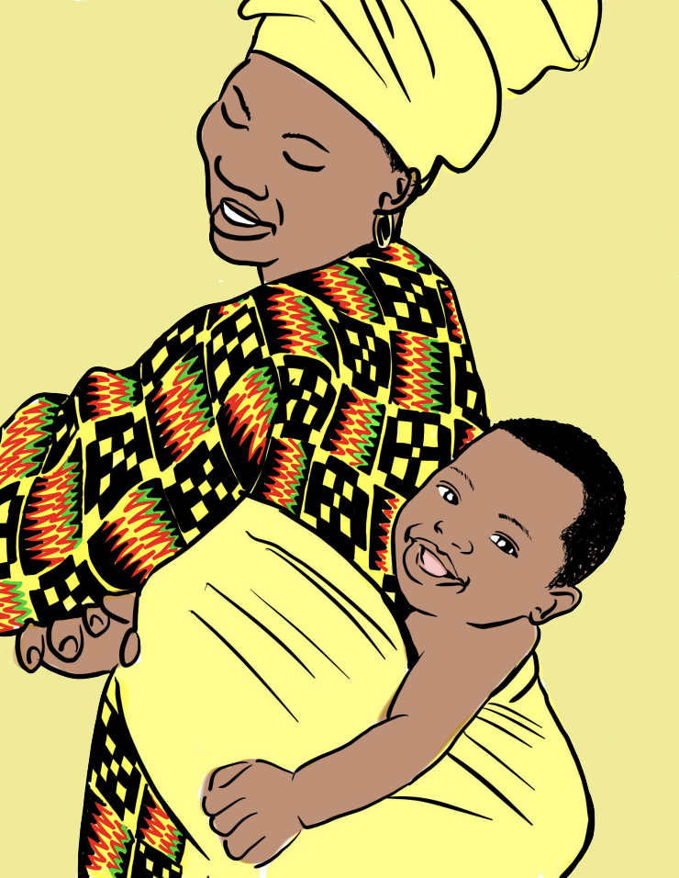
Notes:
Sample poem
Discuss African Geometric Patterns (Today we will be looking at triangular patterns)

Slide 4
equilateral triangle
?
If the interior angles of an equilateral triangle are 60°, what is the size of the exterior angle turn?
60°
?
60°
60°
?

Slide 5
equilateral triangle
120°
Answer = 120 °
You will need to remember this fact when you are programming today.
60°
120°
60°
60°
120°

Slide 6
PRIMM
Predict
On your own, think and write down your detailed prediction for this program.

Slide 7
PRIMM
Run
Run the program on this link
https://scratch.mit.edu/projects/882435584
What part of the code did you predict correctly?
Any part that you missed?

Slide 8
PRIMM
Investigate and Modify
Click on and investigate the code.
Try to change the line
Colour
Thickness
Try to modify the code to make a pattern on three triangles

Slide 9
PRIMM
Investigate and Modify
How can you make the code shorter and more efficient?

Slide 10
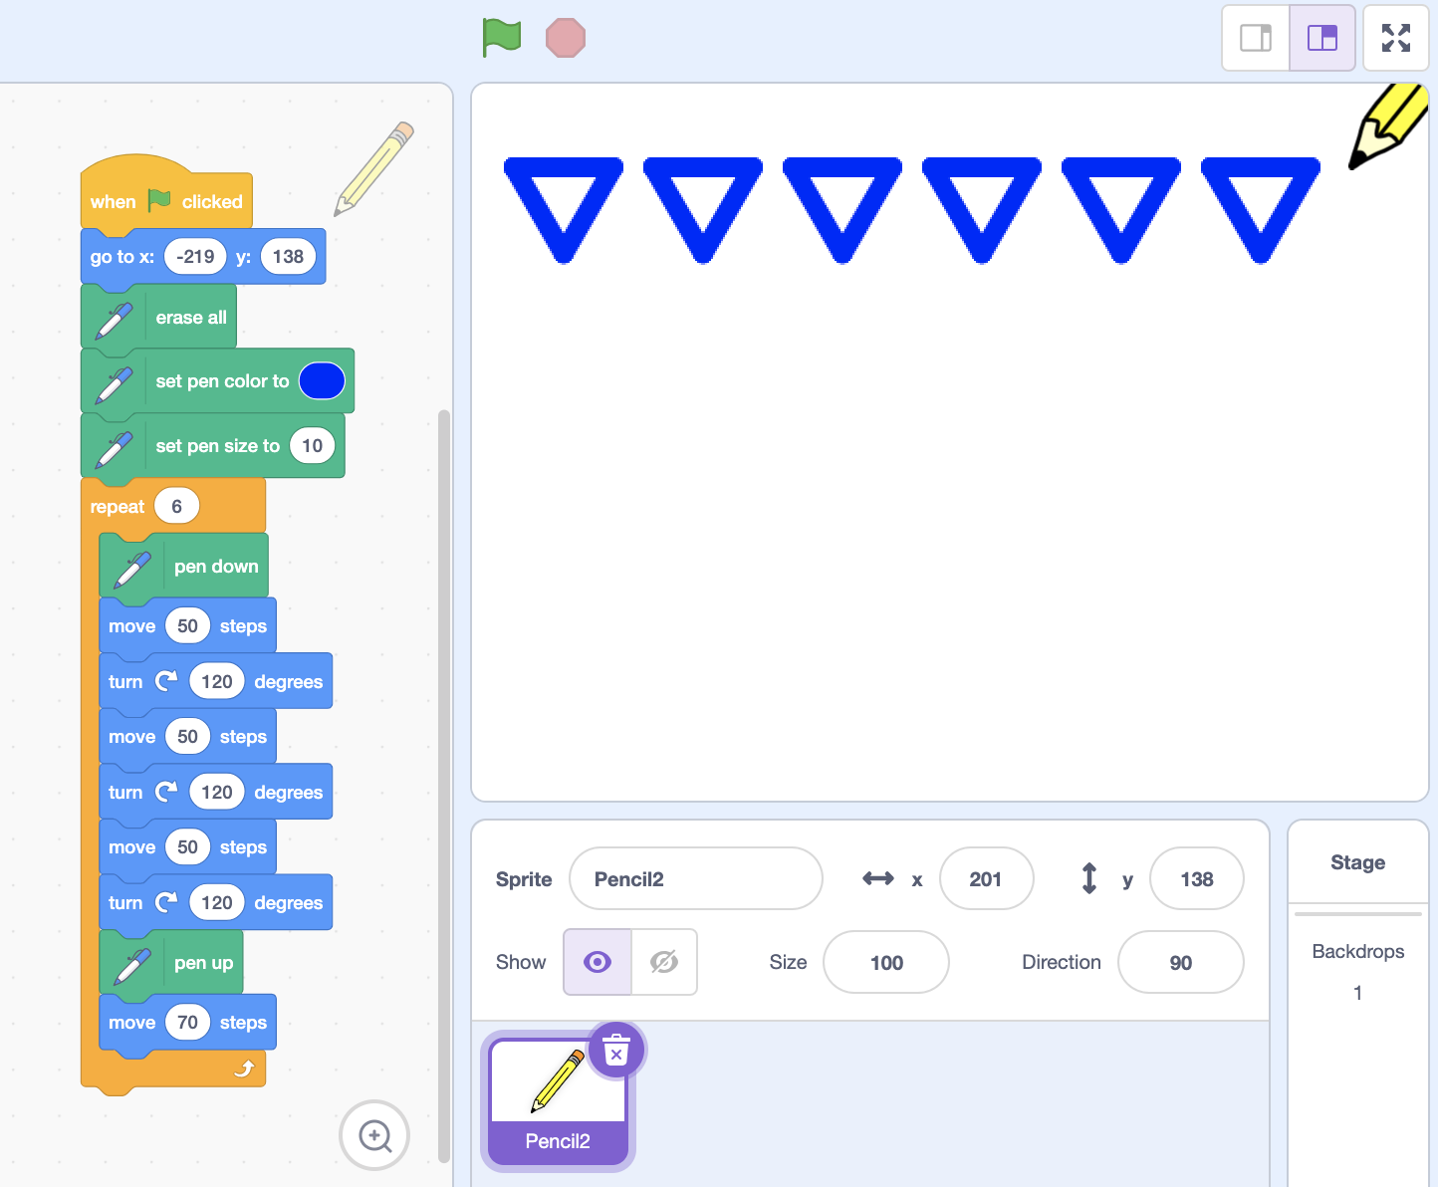
REPEAT / LOOP
Instead of repeating the code, use the repeat block.
What is the advantage of using the repeat block?

Slide 11
NESTED Loops
You can even use loops within loops.
This is called nested loops.

Slide 12
AFRICAN PATTERN CODING CHALLEGE
Use the following algorithm to code an African textile design.
Algorithm
1. At the start of the program, the pencil should go to the top left of the canvas. This would be the original starting point.
2. Then draw 6 repeated triangles cross the screen. After that the pencil should move down to the next line and all the way across below the original starting point.
3. Repeat step 2 process 4 times, but each time, the pencil should have a different colour.

Slide 13
PRIMM
Make
Here is an example solution. Your code can be different from this one.
Now, make your own code from scratch. This can be for your own textile design.

