Slide 1
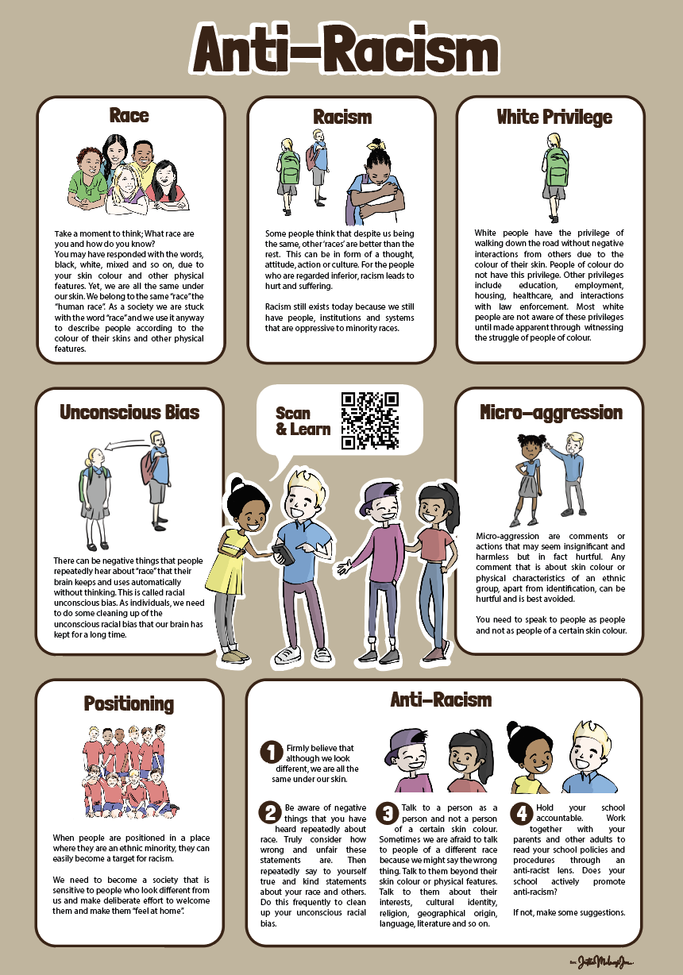
Notes:
Hopefully you have ordered and displayed this poster before this session.

Slide 2
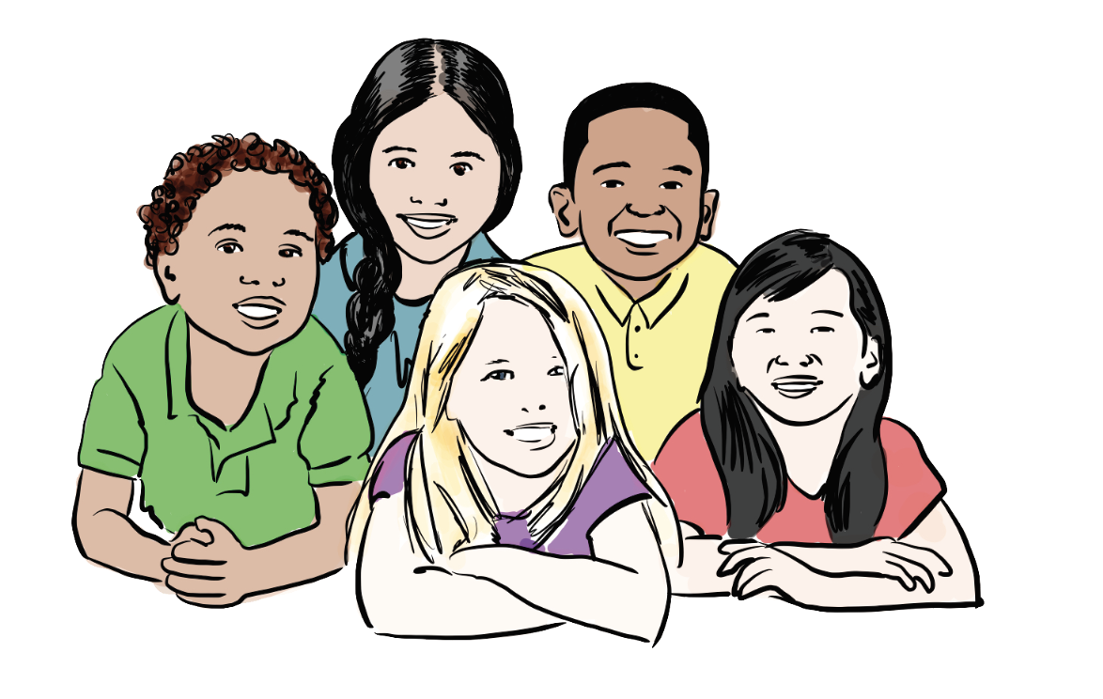
What race are you?
Notes:
Take a moment to think; What race are you and how do you know?
You may have responded with the words, black, white, mixed and so on, due to your skin colour and other physical features.
Yet, we are all the same under our skin.
We belong to the same “race” the “human race”. As a society we are stuck with the word “race” and we use it anyway to describe people according to the colour of their skins and other physical features.

Slide 3
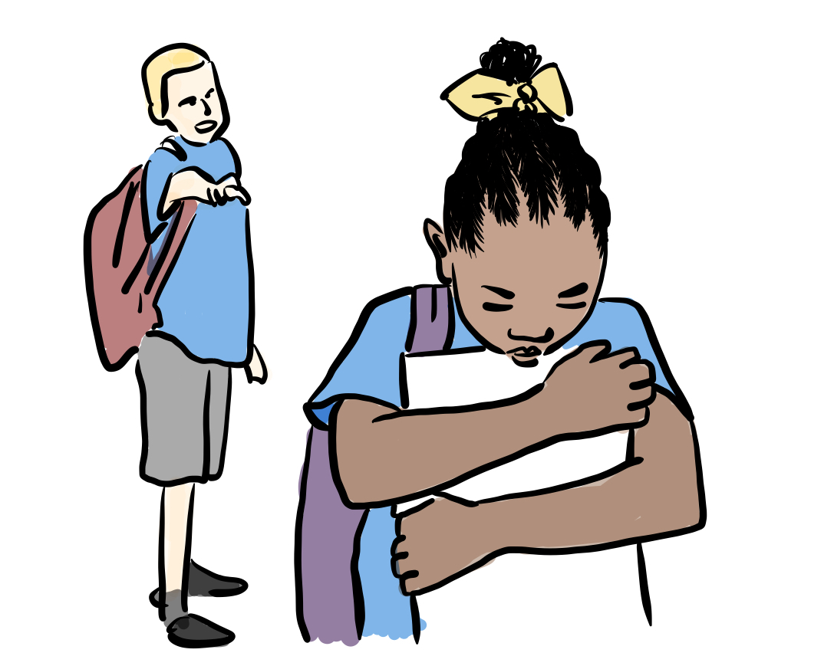
What is racism? Why does it still exist?
Think, Pair, Share
Notes:
What is racism? (Think, Pair, Share)
Some people think that despite us being the same, other ‘races’ are better than the rest. This can be in form of a thought, attitude, action or culture. For the people who are regarded inferior, racism leads to hurt and suffering.
Racism still exists today because we still have people, institutions and systems that are oppressive to minority races.

Slide 4
Racial Positioning
What is good or bad about being in this team?
Think, Pair, Share
Notes:
Kizito was in a football team which almost everyone belonged to the same ethnicity as him.
What is good or bad about being in such a team?
--------------------------------------------------------------------------------------------------------------------
Then he joined another team where everyone was of a different ethnicity from him.
What is good or bad about being in such a team?
What negative things could happen to Kizito in this team but not the first?
As Kizito moves from the position of ethnic majority to minority, he could face racism.

Slide 5
Racial Positioning
What is good or bad about being in this team?
Think, Pair, Share
Notes:
This could also happen to Joe who has joined Kizito’s old team.
----------------------------------------------------------------------------------------------------------------------------------------------
Think about the positioning of Sam, a mixed-race child. What is good or bad about Sam being in both teams?
When people are positioned in a place where they are an ethnic minority, they can easily become a target for racism. We need to become a society that is sensitive to people who look different from us and make deliberate effort to welcome them and make them “feel at home”.

Slide 6
What is Unconscious Racial Bias?
Notes:
There can be negative things that people repeatedly hear about “race” that their brain keeps and uses automatically without thinking.
This is called racial unconscious bias.
As individuals, we need to do some cleaning up of the unconscious racial bias that our brain has kept for a long time.

Slide 7
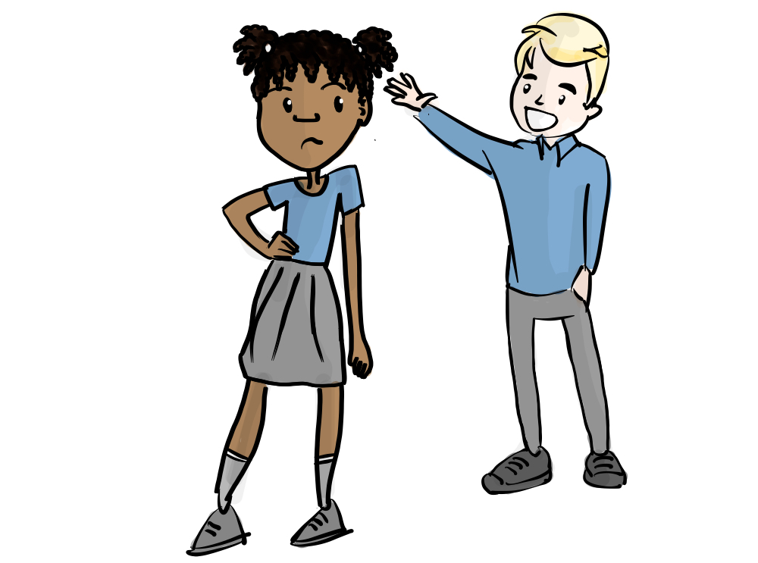
What is Micro-aggression?
Notes:
Micro-aggression are comments or actions that may seem insignificant and harmless but in fact hurtful. Any comment that is about skin colour or physical characteristics of an ethnic group, apart from identification, can be hurtful and is best avoided.
You need to speak to people as people and not as people of a certain skin colour.

Slide 8
What is being anti-racist?
Notes:
To be anti-racist is to go against racism. This starts with firmly believing that we are all the same under our skin. We all belong to one race, the human race. We should therefore respect each other as equal people.
Ignoring racism adds to racism, because racism is allowed to carry on as normal. We need to be a society that does not stand-by and watch a racist incident happening. Racism is unacceptable and we must always challenge it.

Slide 9
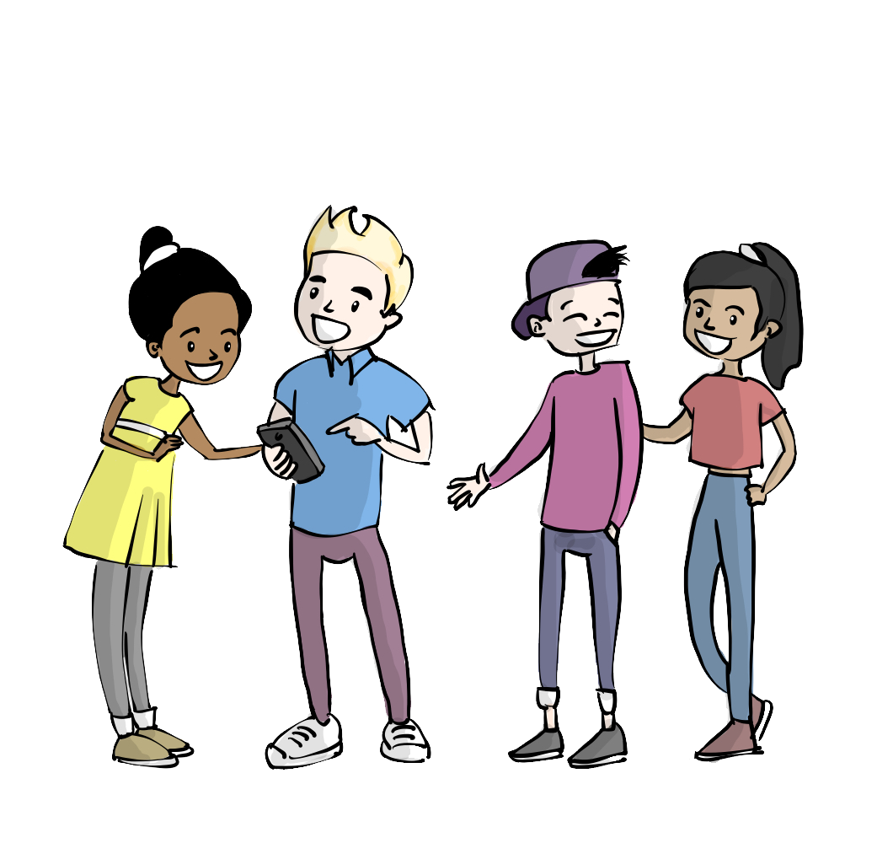
How to be anti-racist
Notes:
1- Firmly believe that although we look different, we are all the same under our skin.
2- Take time to think about negative things that you have heard repeatedly about race. Truly consider how wrong and unfair these statements are. Then repeatedly say to yourself true and kind statements about your race and others. Do this frequently to clean up your unconscious racial bias.
3- Talk to a person as a person and not a person of a certain skin colour. Sometimes we are afraid to talk to people of a different race because we might say the wrong thing. Talk to them beyond their skin colour or physical features. Talk to them about their interests, cultural identity, religion, geographical origin, language, literature and so on.

Slide 10
Activity 1
Philosophy Talk
Should top jobs give priority to ethnic minorities?
Notes:
Please change the question to what ever is good for discussion with your children

Slide 11
Activity 2
Art and Design
Design a poster to promote a message of anti-racism
Notes:
Please change the task to what ever is good for your children

Slide 12
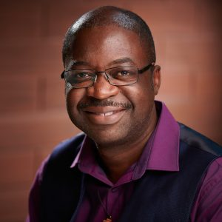

Rev. Deacon
www.malewezi.com
#malewezi
Notes:
I would greatly appreciate if you tell the children about author of resources. More info is on the link
https://malewezi.com/about-justin-malewezi-jnr/
If you are going to promote the children’s work online, please include hashtag #malewezi

