Slide 1
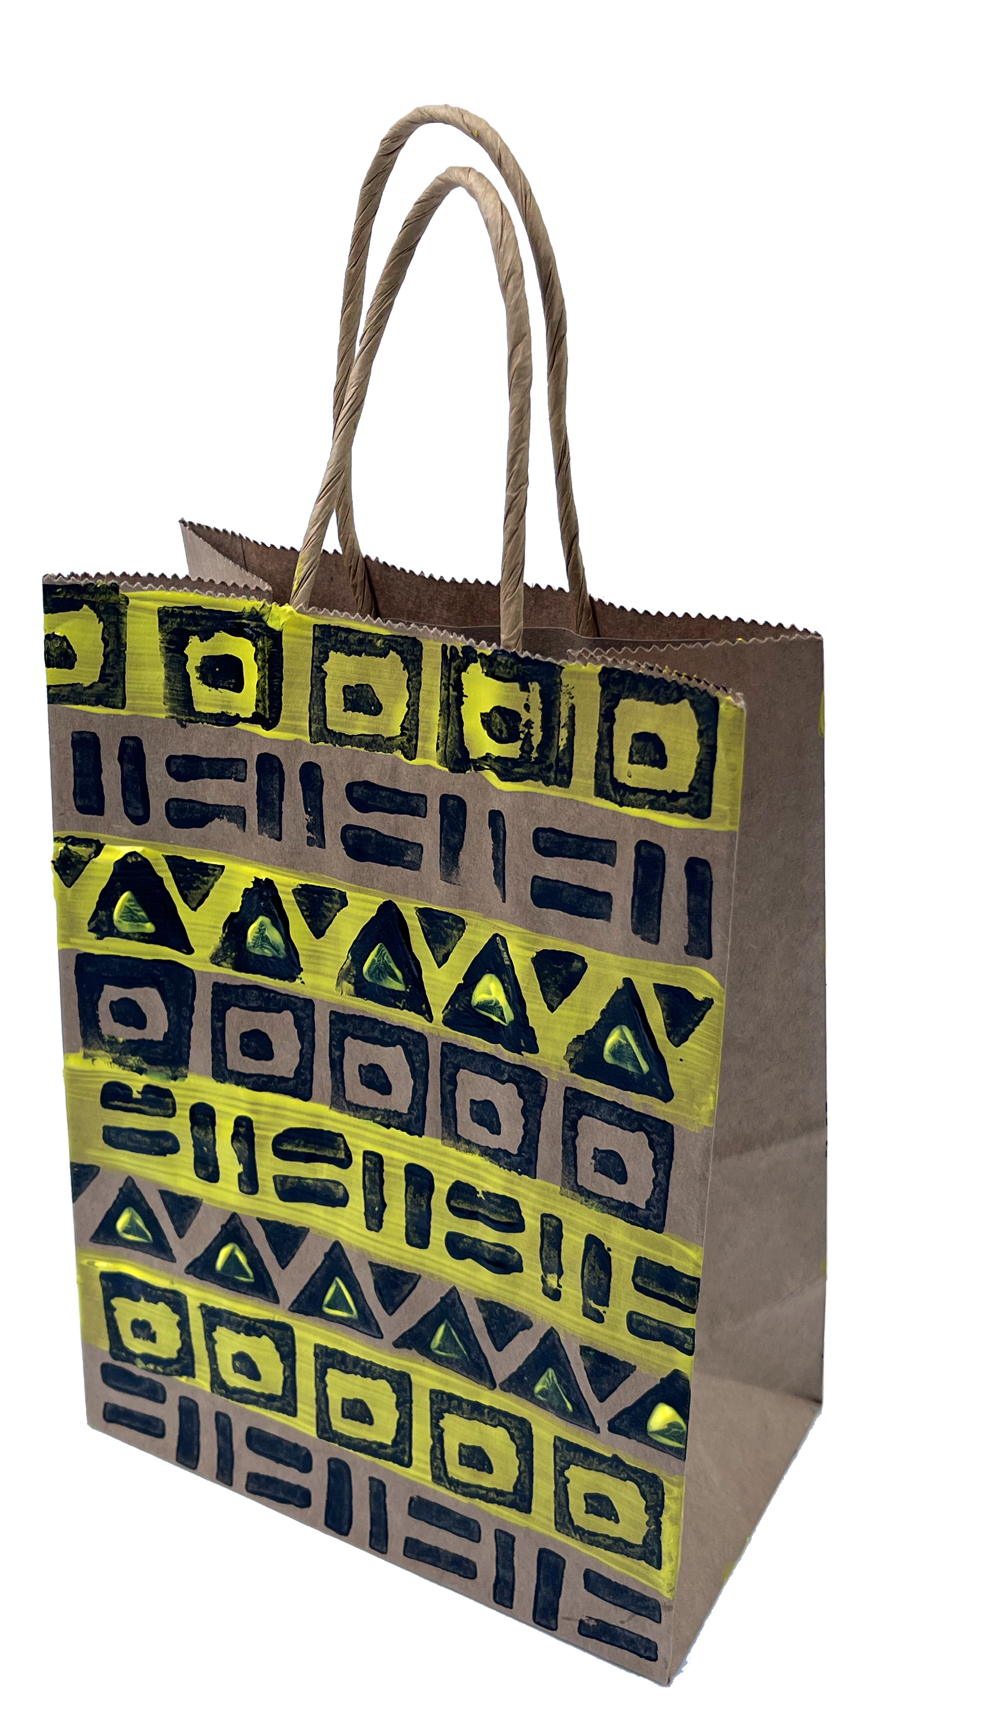
AFRICAN PATTERN PRINTING
An Art and Design activity from the book “Smile Back” by

Slide 2
Notes:
Book cover

Slide 3
Notes:
Sample poem

Slide 4
EQUIPMENT
Paint
Gift bag to print on
2 potatoes
Safe knife

Slide 5
Design
Sketch your own pattern
What geometric shapes do you need for your pattern?
Plan your colours

Slide 6
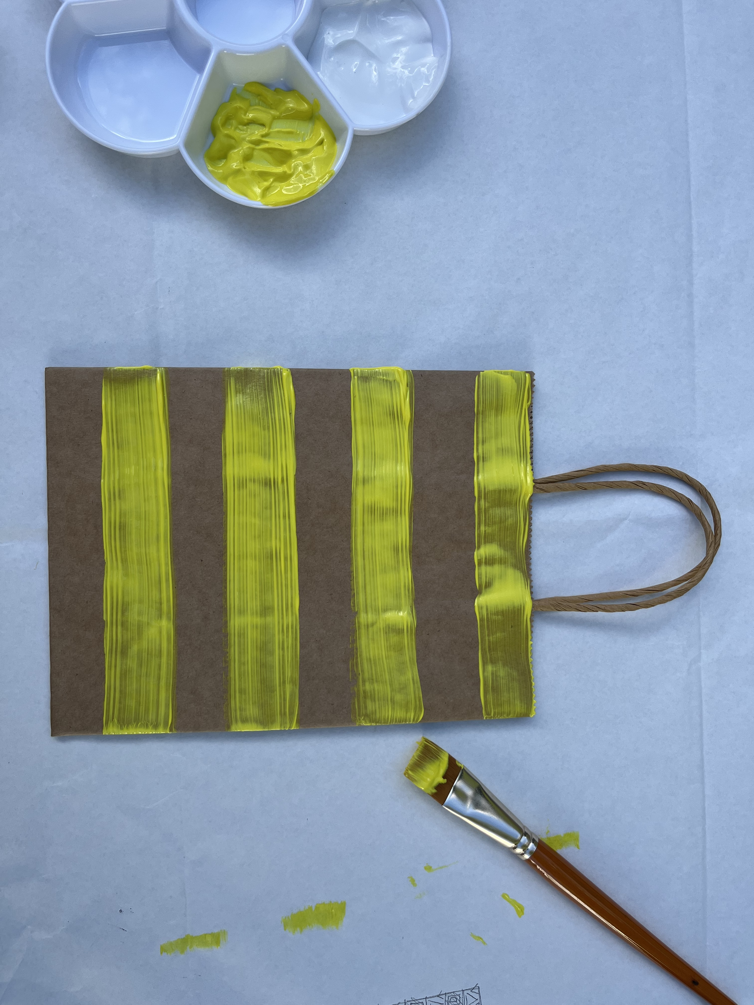
BACKGROUND
Paint your background colour pattern
Leave to dry

Slide 7
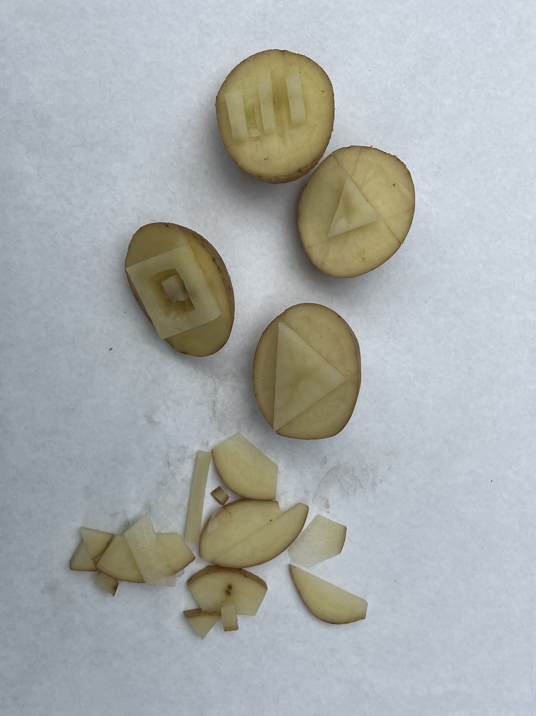
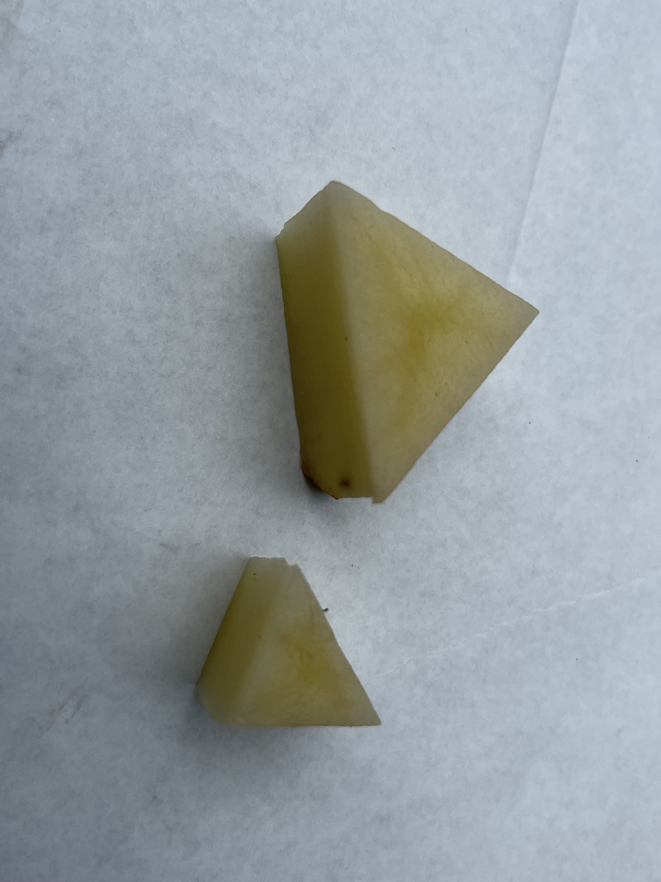
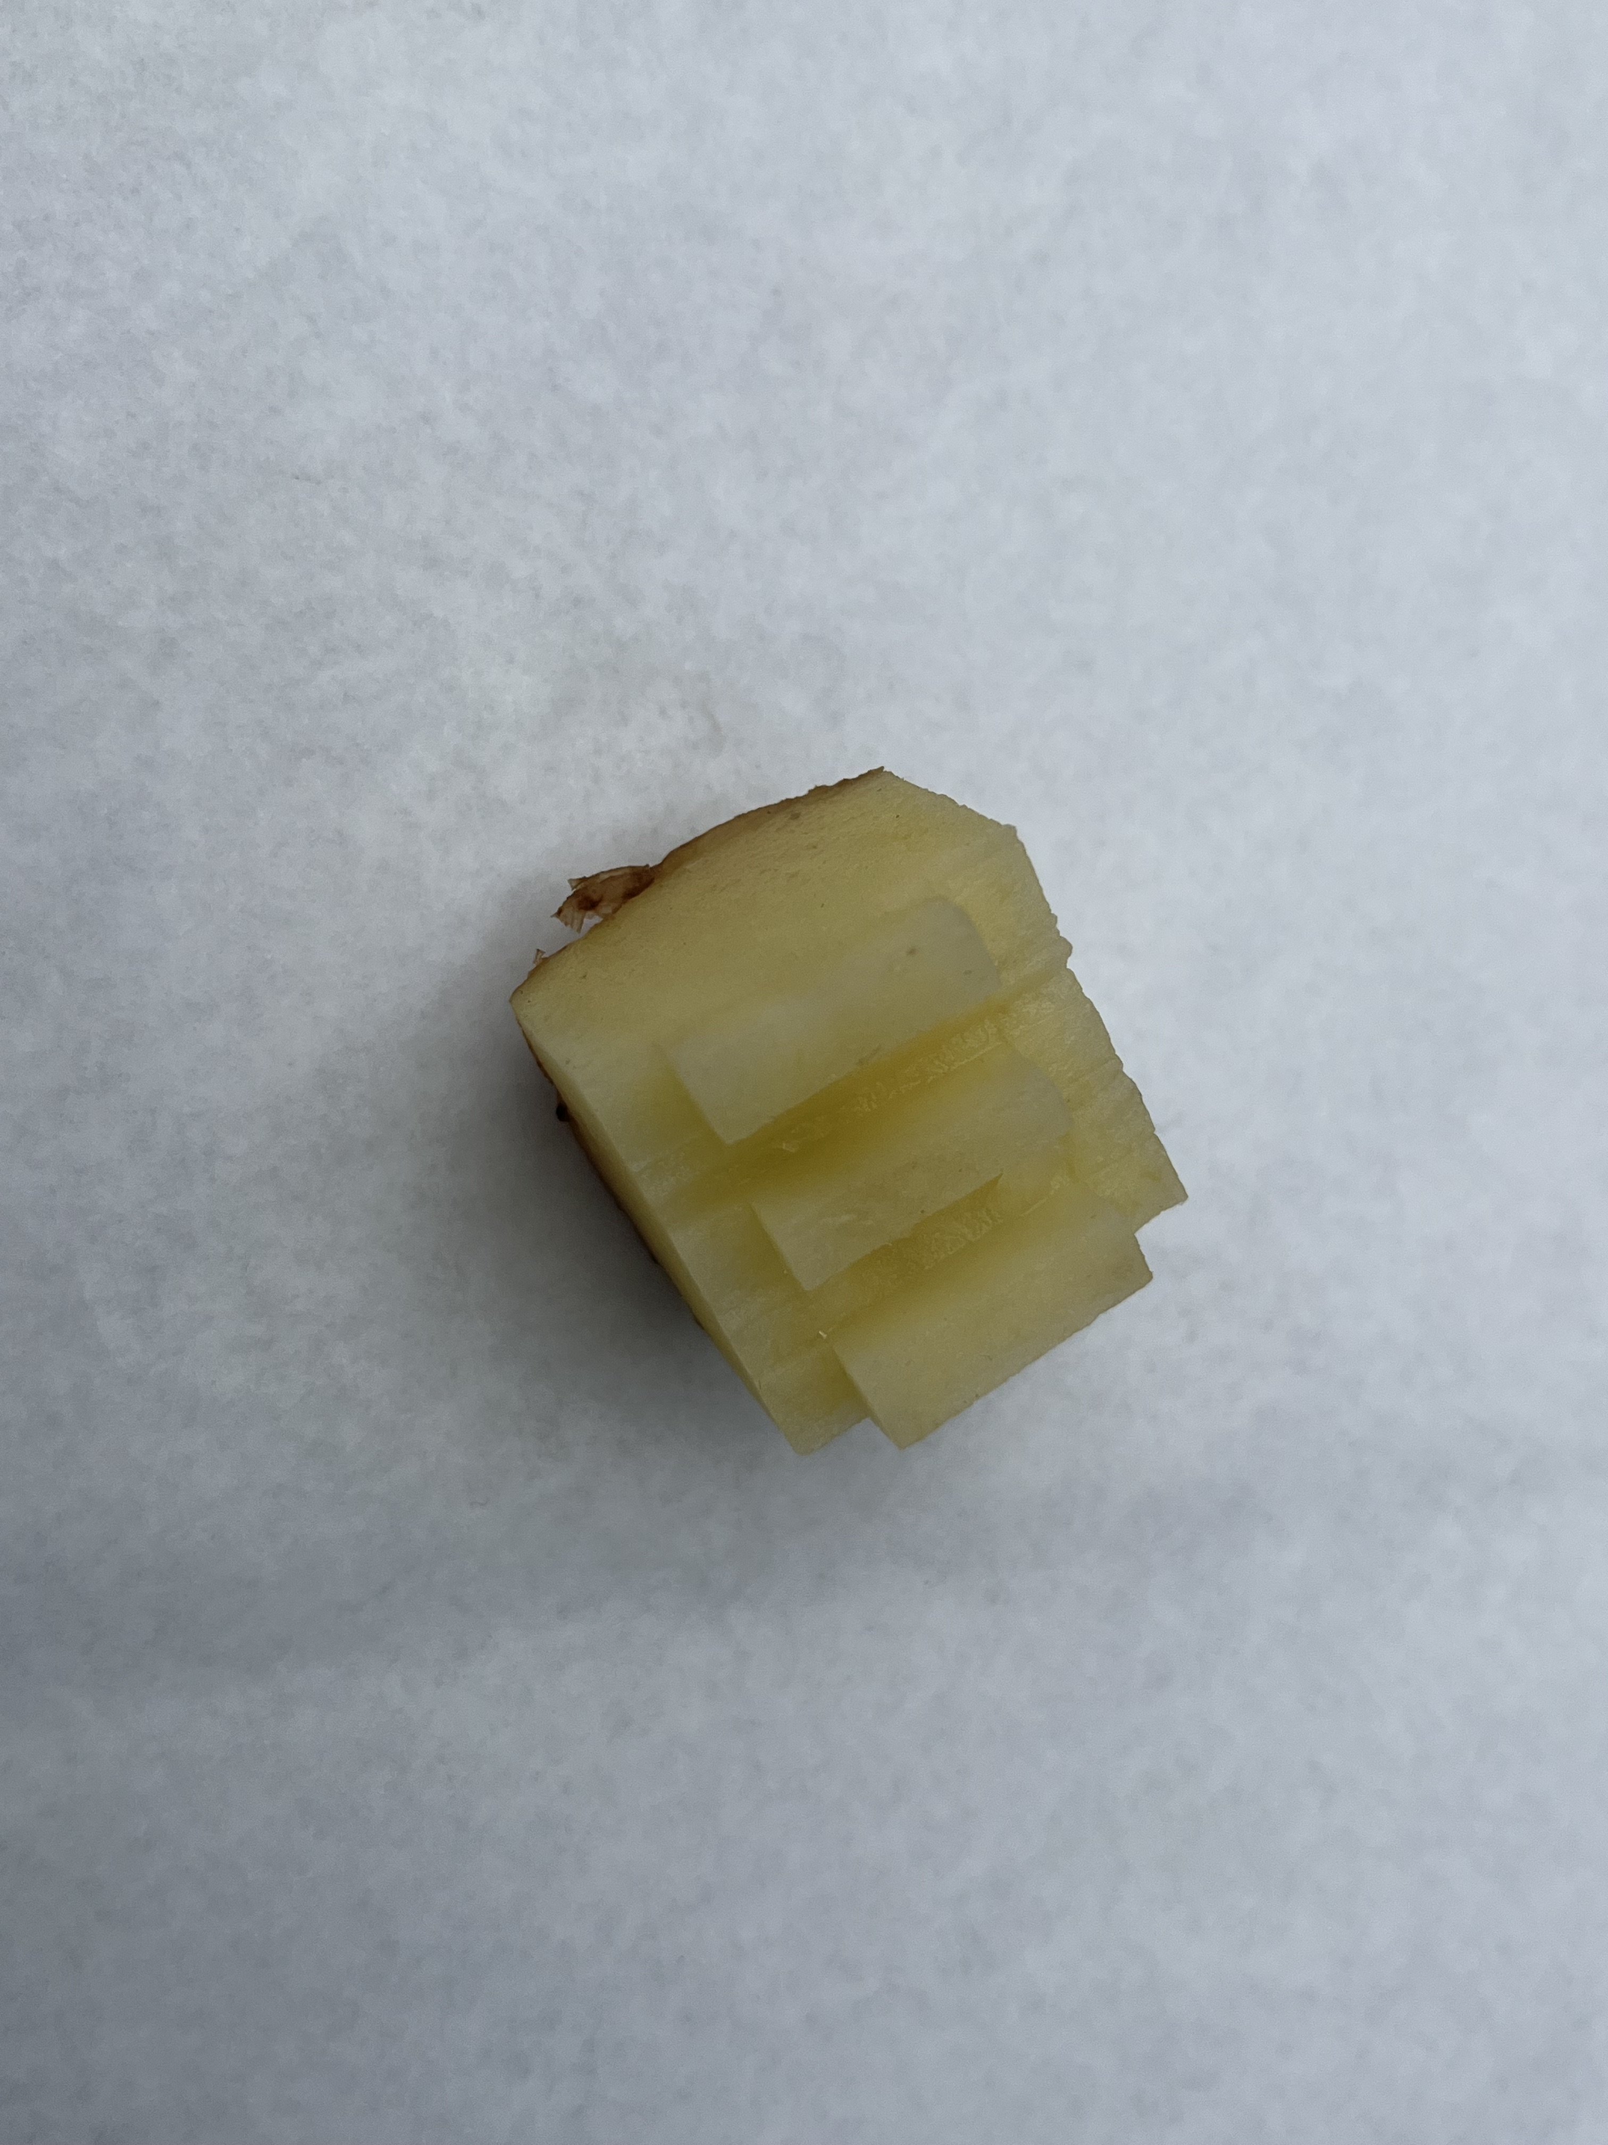
PRINTING stamps
Cut the potatoes in half
Create your geometric printing stamps

Slide 8
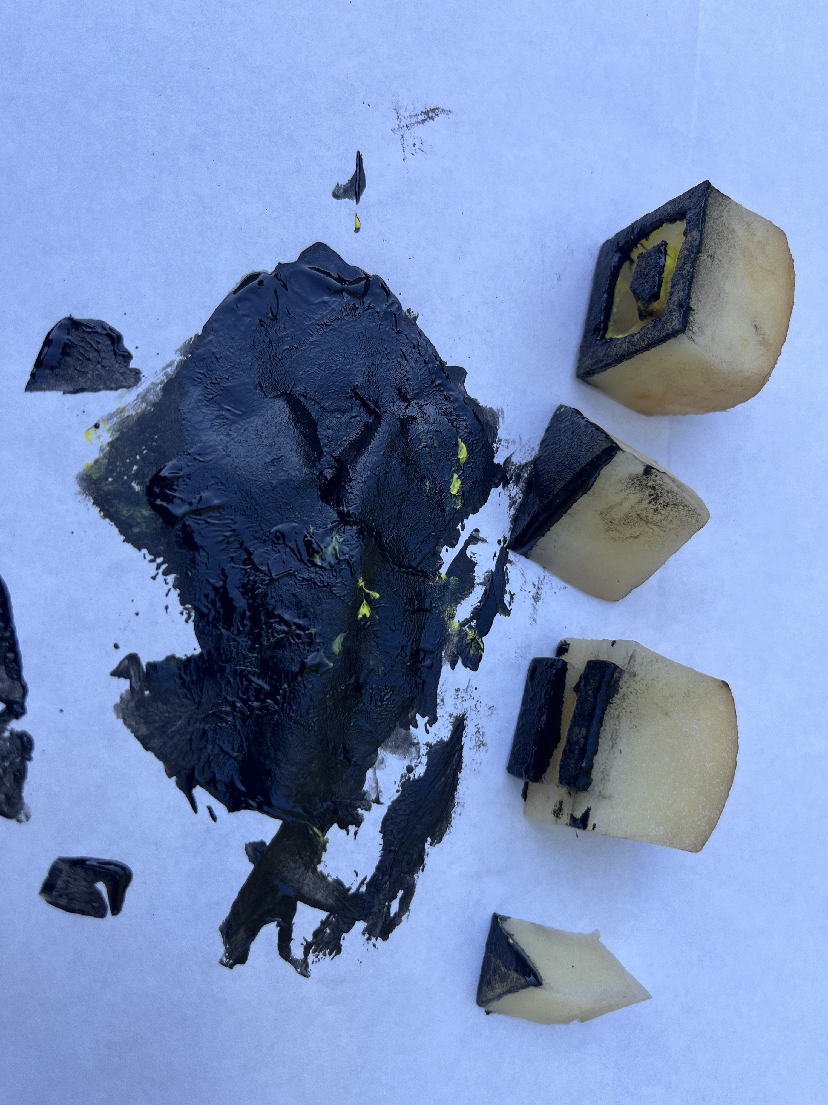
INKING and PRINTING
Dip the stamp in paint and dab on plain paper to spread the ink evenly
Then print your pattern by stamping on the gift bag.

